Slide 1
The Citation Life Cycle of ETDs in Taiwan
Yi Shuan Huang PhD student, National Taiwan University
Lee Chen Chen Associate professor, National Ilan University
Bao-Tzuoh Huang Professor, National Ilan University

Slide 2
Outline
Introduction
National Digital Library of Theses and Dissertations in Taiwan
Open Access
The Immediacy Index of OA and non-OA ETDs
Research Purpose
Research Methods
Research Findings
Conclusion

Slide 3
National Digital Library of Theses and Dissertations in Taiwan(1/3)
An open full-text database, http://ndltd.ncl.edu.tw/
Our National Central Library, as delineated in the Degree Deferral Law, is the only legal depository for theses and dissertations in Taiwan. NCL has done just that in creating a database that makes possible freedom in research dissemination, the reduction of the urban-rural gap, and equality in academics.
The system is a national academic research support platform through the assistance of colleges and universities across Taiwan.
Since participating institutions do not need to create separate databases, this translates into reduced costs for universities in terms of computer hardware, system maintenance, and IT personnel.

Slide 4
National Digital Library of Theses and Dissertations in Taiwan(2/3)
The third generation system developed by the NCL
1970: print catalog
1997: WebPac system(catalog online)
2010: full-text database
Over 950,000 records, also uploaded to the NDLTD Union Archive
More than 360,000 electronic theses is available online
About 220,000,000 visitors since 2010

Slide 5
National Digital Library of Theses and Dissertations in Taiwan(3/3)

Slide 6
Open Access
Read the Budapest Open Access initiative(2002)
Free and unrestricted online availability
Gives readers extraordinary power to make use of relevant literature
Hope to help open up access to the rest of this literature and remove the barriers, especially the price barriers
Permit any users to download, copy, print, or link to the full texts without financial, legal, or technical barriers
The only constraint about open access is that should give authors the right to be properly acknowledged and cited

Slide 7
The Immediacy Index of OA and non-OA ETDs
Table 4 Cited during published year number of OA ETDs
Year | Random sample number | Cited during published year | Immediacy index
2008 2009 2010 2011 2012 | 500 500 500 500 500 | 43 38 36 72 81 | 0.08 0.07 0.07 0.14 0.16
In our previous research in 2014, we found a significant difference between the immediacy index of OA and Non-OA ETDs
Table 4 reveals the average immediacy index of OA published during 2008-2012 is about 0.1, whereas Table 5 shows the average immediacy index of non-OA is 0.
The immediacy index of OA published during 2008-2012 has shown a tendency to increase.
Table 5 Cited during published year number of non-OA ETDs
Year | Random sample number | Cited during published year | Immediacy index
2008 2009 2010 2011 2012 | 500 500 500 500 500 | 0 1 2 1 0 | 0 0 0 0 0
Notes:
The immediacy index measures the speed by which articles make an impact on readers

Slide 8
Research Purpose
To identify the development of OA ETDs in recent years in Taiwan
To compare the difference of citation life cycle between OA and non-OA ETDs in Economic, Chinese, Medical, and Computer science field

Slide 9
Research Methods
The research data of this paper is based on bibliometric and citation analysis of OA and non-OA ETDs.
Our measurement of quantitative statistics is focused on Number of OA on ETDs, Number of ETDs, published year, department, and citation count.
We conduct the study in the 50 random samples by each year of OA and non-OA ETDs in different department.
The research setting is in the National Digital Library of Theses and Dissertations (NDLTD) in Taiwan (http://ndltd.ncl.edu.tw/)
3-stage life cycle analysis: the first sub-period, the second sub-period and the forward period

Slide 10
Research Findings

Slide 11
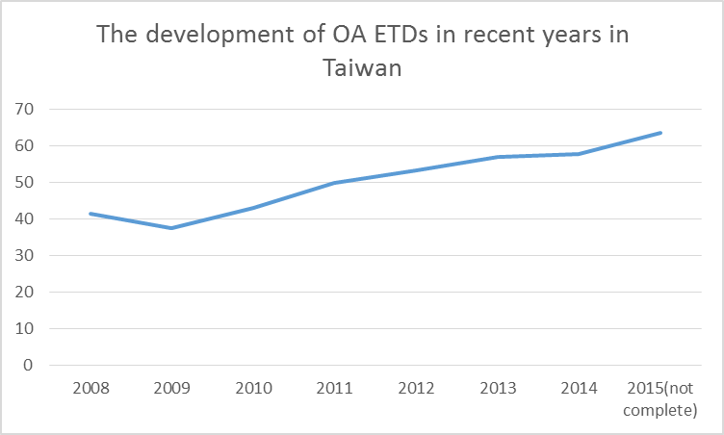
The recent development of OA ETDs in Taiwan
Published year | OA ETDs | ETDs | OA rate (%)
2008 | 25,455 | 61,232 | 41.57
2009 | 23,680 | 63,118 | 37.52
2010 | 27,101 | 62,784 | 43.17
2011 | 31,667 | 63,539 | 49.84
2012 | 33,683 | 63,186 | 53.31
2013 | 34,521 | 60,534 | 57.03
2014 | 34,270 | 59,259 | 57.83
2015(not complete) | 4,788 | 7,532 | 63.57
total(1956 till now) | 364,718 | 953,089 | 38.27
Since the 2011, the OA rate in Taiwan has been above 50%.
Over the whole observation period, from 1956 till now, the OA rate has been approximately 38% in average. The OA rate has exceptionally reached 60% after the 2014, thanks to a robust digital and knowledge platform.

Slide 12
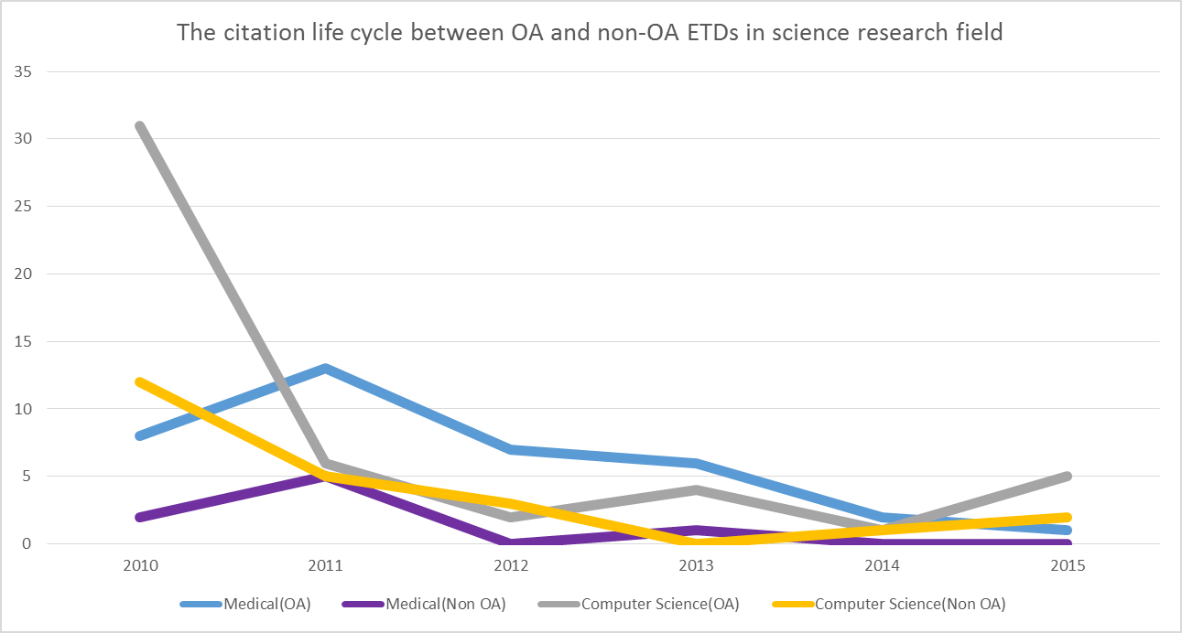
The citation count of Medical and Computer Science: Low-count case
The citation count of Medical
Published year | OA ETDs | Non OA ETDs
2010 | 8 | 2
2011 | 13 | 5
2012 | 7 | 0
2013 | 6 | 1
2014 | 2 | 0
2015 | 1 | 0
Dividing the 5 observation years into two sub-periods of equal length, we find the counts of the two low-count fields increase smoother between 2013 and 2015. Over the second sub-period of 2010-2012, counts also increase smoother in it’s early stage.
The citation count of Computer Science
Published year | OA ETDs | Non OA ETDs
2010 | 31 | 12
2011 | 6 | 5
2012 | 2 | 3
2013 | 4 | 0
2014 | 1 | 1
2015 | 5 | 2

Slide 13
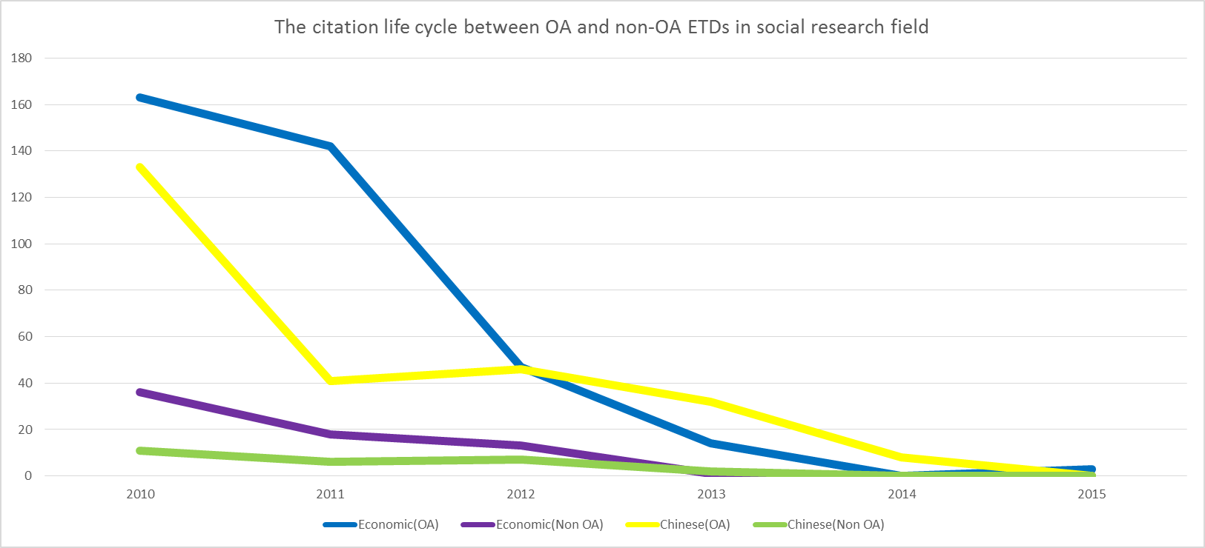
The citation count of Economic and Chinese Field: High-counts case
The citation count of Economic
The figure sheds light on the puzzling citation development through the period comparison of these two fields performance with those of the above two sciences. Both the life cycle figures develop quite similarly over the first sub-period of 2013-2015, but diverge thereafter(or the second sub-period).
Published year | OA ETDs | Non OA ETDs
2010 | 163 | 36
2011 | 142 | 18
2012 | 47 | 13
2013 | 14 | 1
2014 | 0 | 0
2015 | 3 | 0
The citation count of Chinese
Published year | OA ETDs | Non OA ETDs
2010 | 133 | 11
2011 | 41 | 6
2012 | 46 | 7
2013 | 32 | 2
2014 | 8 | 0
2015 | 0 | 0

Slide 14
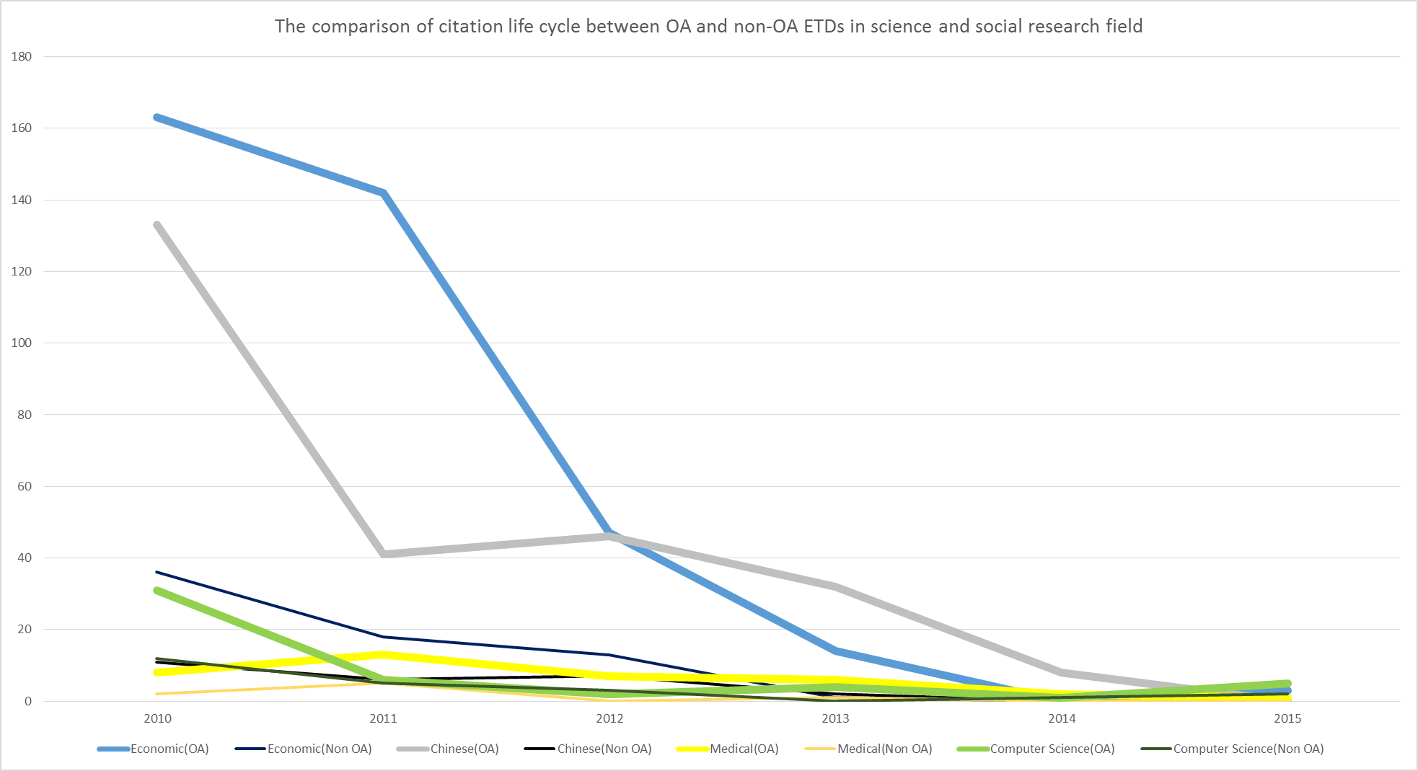
Conclusion (1/3): The citation life cycle – Two sub-period analysis
According to the citation count of Economic, Chinese, Medical, and Computer Science, it is obvious that the open access would make more citing opportunities in different field. However, there have been important differences in the development of the second sub-period.
The citation life cycle in the selected 4 fields:
In Medical and Computer science fields, both OA and Non OA ETDs are showing lower citation count and slowing considerably after the second sub-period.
The expansion stage of Economics (published after 4 years) is happened earlier than Chinese Literature (published after 5 years)
Compared with sciences, the expanding citations of economic and Chinese fields, may increase citing productivity via increasing the precedent analysis and historical data reuse.

Slide 15
Conclusion (2/3): The citation life cycle of OA and Non-OA ETDs – Two cross-point analysis
Cross point 1 & 2 clearly confirm the most pronounced and mediating role, which can turn the situation upside down, in the citation life cycle of OA and Non-OA ETDs in Taiwan. First, the growth period of Non-OA ETDs is delayed one year than OA ETDs. Secondly, the decline period of Non-OA ETDs is always happened earlier than OA ETDs at about 5 years after the initially published.
Cross point 1
Before: the citation count of OA outpacing Non-OA
After: the citation count of OA is lower than Non-OA
Cross point 2
Before: the citation count of OA is lower than Non-OA
After: the citation count of OA most noticeably re-surpassing Non-OA

Slide 16
Conclusion (3/3): The expected citation life cycle – Two forward shape analysis
In absolute terms, the largest widening gap of the two locus came from the 4 years after published, followed by the converging during the 4-5 years after published, whereas it diverged thereafter which one locus lift up but the another’s tearing down. After the published 6 years or forward years, the increase in OA-ETDs will expect to remain fairly high, whereas it will expect to grow steady and converge to constant level in Non-OA ETDs. The exact locus and shape of these curves will vary greatly from field to field, and depending on general OA conditions to the different theses vintages published.

Slide 17
Thank you for your listening!

