Slide 1
Indian Electronic Theses and Dissertations: Shodhganga, a platform for improving quality of research in Indian Universities
Manoj Kumar K
Scientist-D(CS)
Shodhganga Division
INFLIBNET Centre/UGC
Infocity, Gandhinagar, GUJARAT.
manoj@inflibnet.ac.in

Slide 2
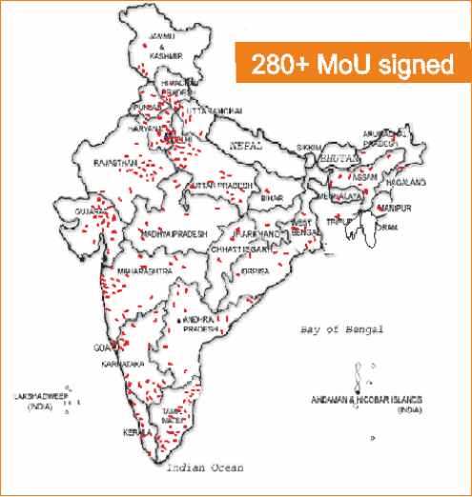
India

Slide 3
- Why Shodhganga?
- What Benefits Research scholars gets?
- Responsibilities
- Status of Implementations
- Contributions
- Feedback
- Honours and Awards
- Future Scope

Slide 4
In 2006
Poor Visibility of Theses
Only 2 Universities Digitised theses
Research Result not publically accessible
Plagiarism
Duplication of Research
Copying
Why Shodhganga?
Poor Access
Sharing restricted due to non availability of softcopy
Non Continuity of Research
manoj@inflibnet.ac.in

Slide 5
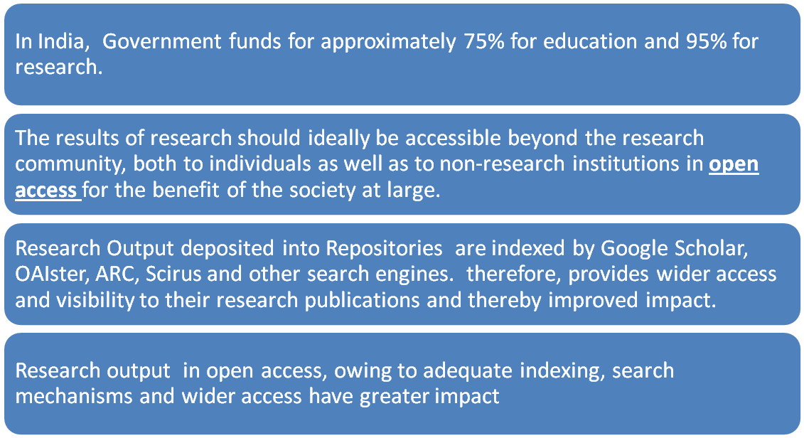
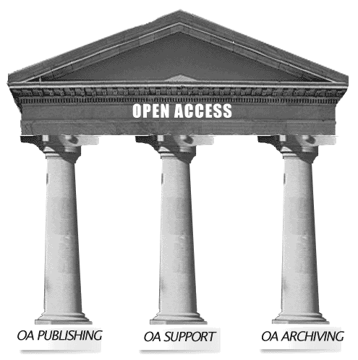
Financial and Technical
Public Access to Research Output
is a Social Responsibility
manoj@inflibnet.ac.in

Slide 6
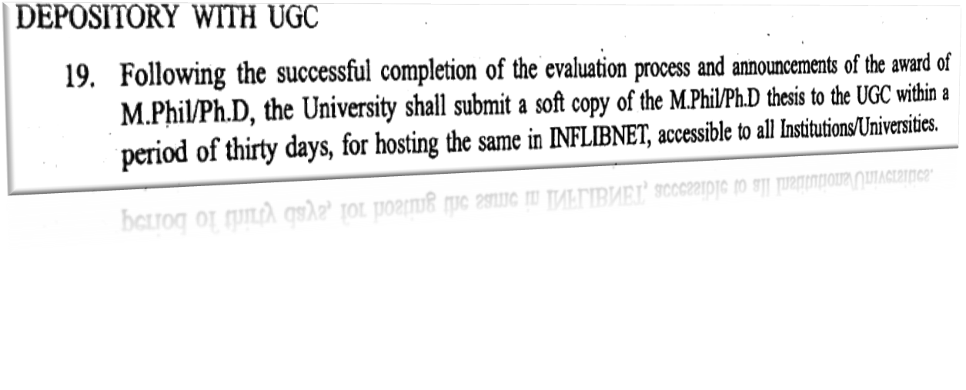
UGC Issued Gazette Notification
UGC Guidelines in 2005 and Notification issued in 2009
National Committee on ETD formed by UGC in 2009
manoj@inflibnet.ac.in

Slide 7
Website/ Portal
Upload/ Maintenance
Ingestion Interface
Role of
Funding/ Awareness
Guidelines/ Responsibities
manoj@inflibnet.ac.in

Slide 8
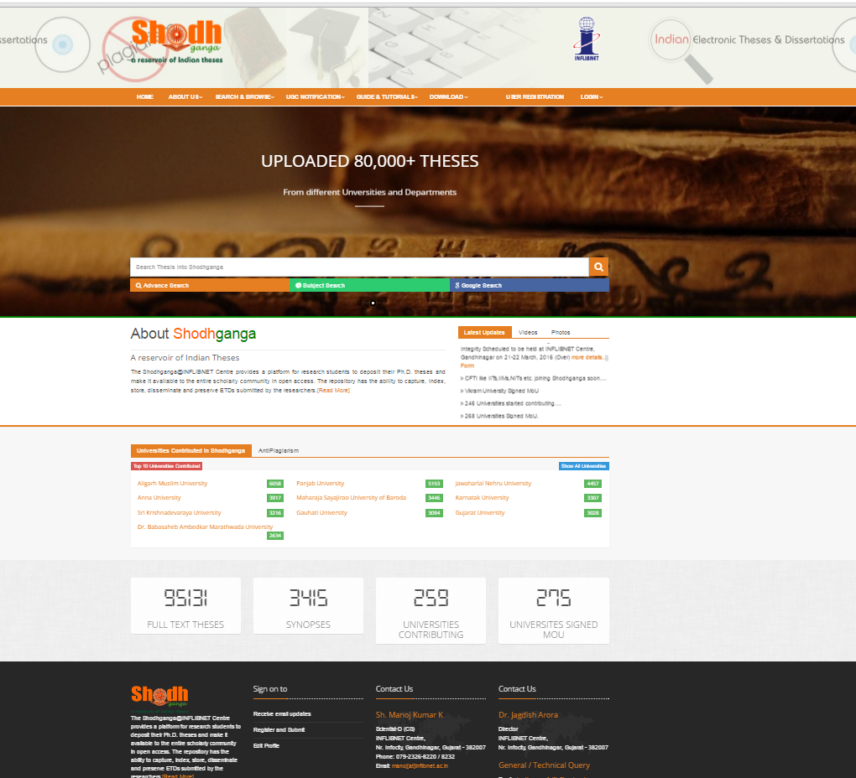
SHODHGANGA Homepage at http://shodhganga.inflibnet.ac.in
95200+ Theses

Slide 10
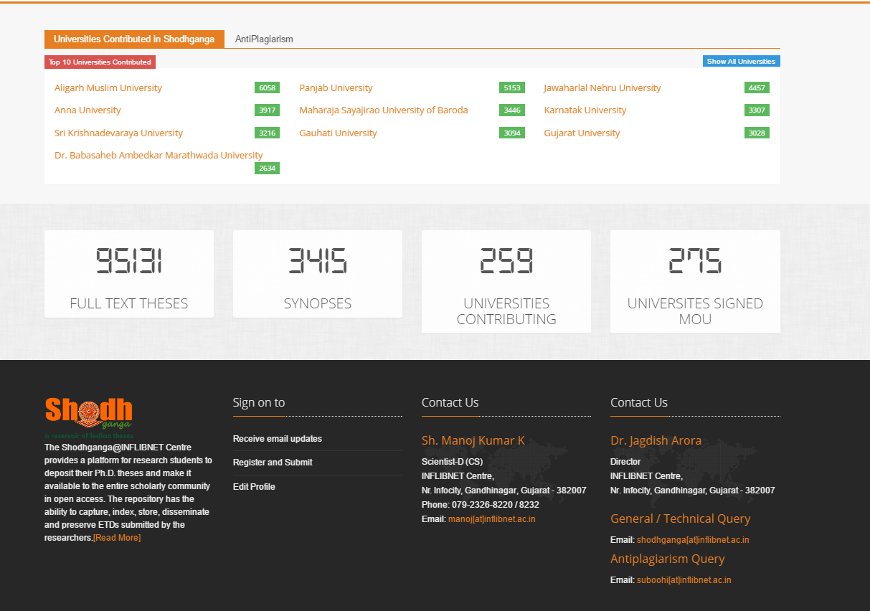

Slide 12
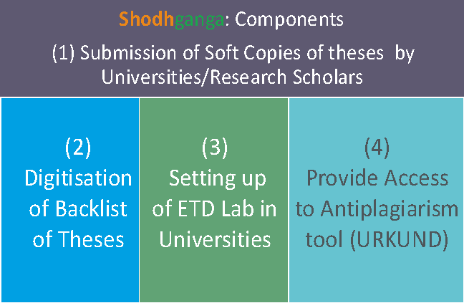
Incentives to Universities

Slide 13
5 July
2016
Status of Shodhganga
1st Jan 2015
No. of Theses Uploaded: 95200
30000
Universities Signed MoU: 280
186
No. of Universities Contributed: 260
196
CFTIs requested to join by MHRD:15
No.F-27-90/2015-TS.II(TC) dt.8th Sept 2015
manoj@inflibnet.ac.in

Slide 14
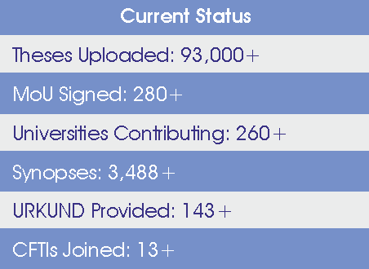

Slide 16
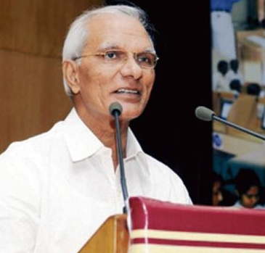
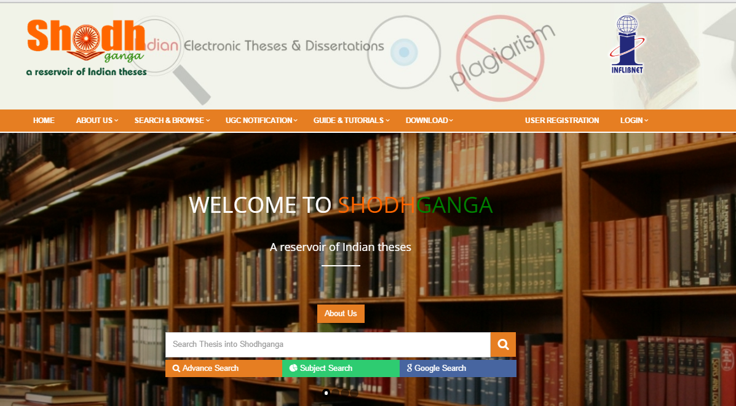
Four Searches in Shodhganga
UGC Chairman uploaded 50000 thesis in Oct 15
FOUR SEARCHES IN Shodhganga

Slide 17
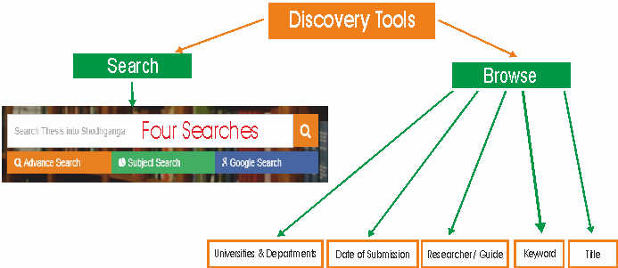
FOUR SEARCHES IN Shodhganga

Slide 18
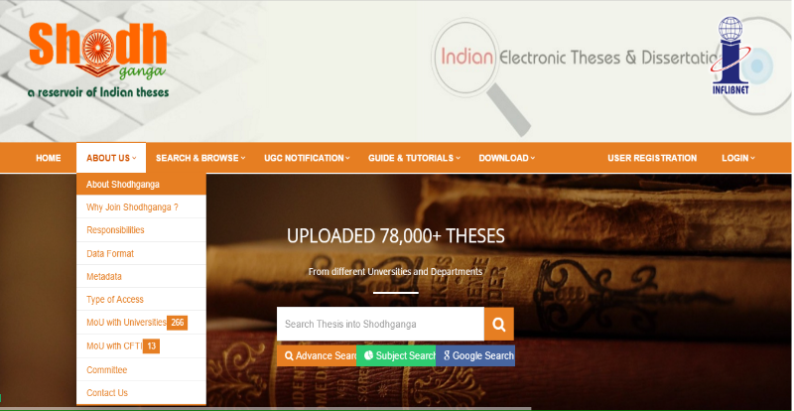
Introduction Area
manoj@inflibnet.ac.in

Slide 19
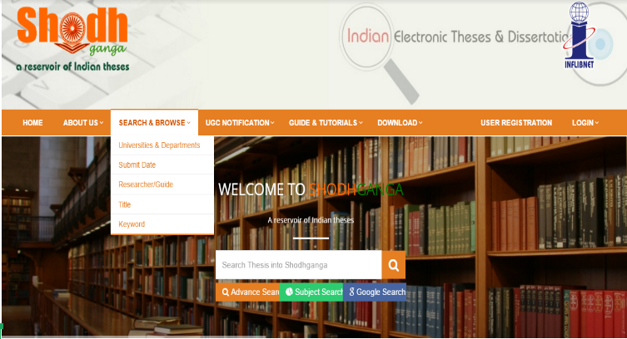
4 Searches in Home Page

Slide 20
Technical Detail

Slide 21
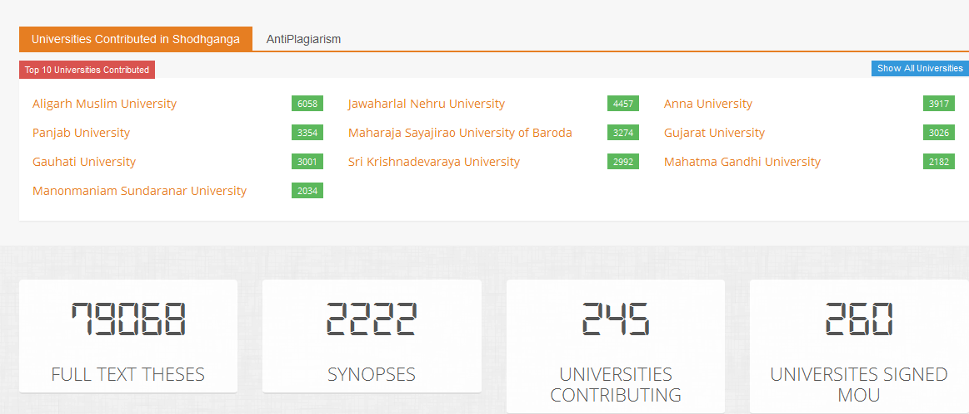

Slide 22
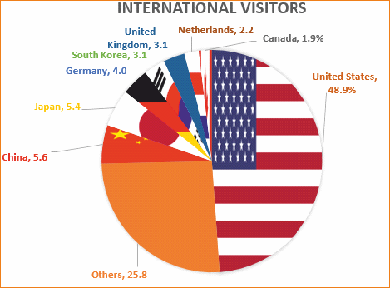

Slide 23
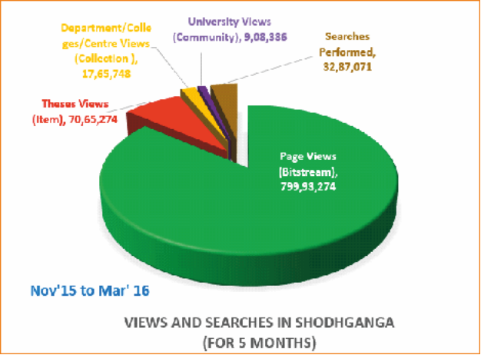

Slide 24
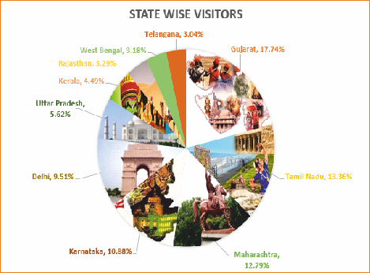

Slide 25
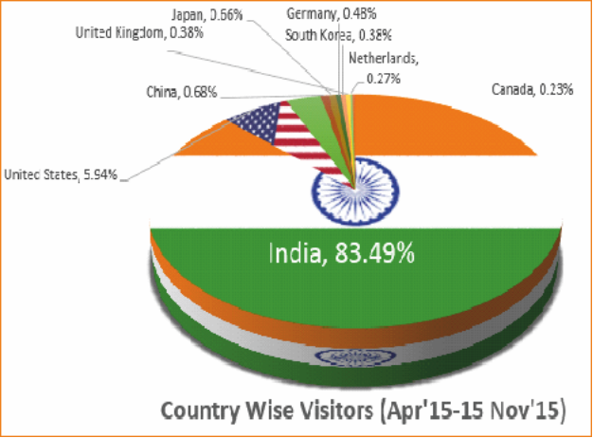

Slide 26
50+ Awareness Programmes Conducted in various regions
Rajasthan
Kerala
Pondichery
Gujarat
Tamil Nadu
Tripura
New Delhi
Maharashtra
Gujarat
manoj@inflibnet.ac.in

Slide 27
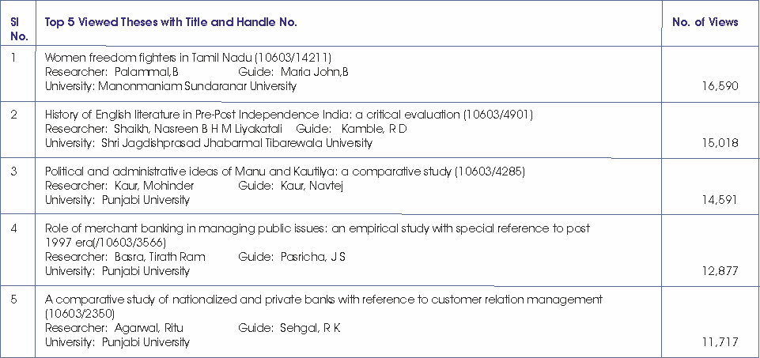
Top 5 Viewd Theses

Slide 28
Workflow

Slide 29
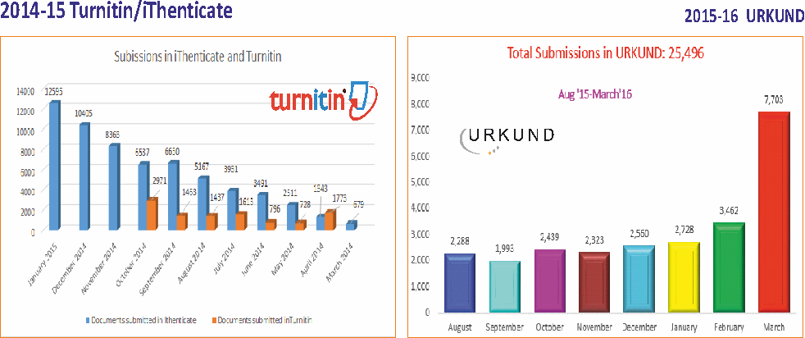

Slide 31
Major Universities Signed MoU
MoU Signed on 13th October 2011
280+ Universities signed MoU
manoj@inflibnet.ac.in
Notes:
31

Slide 32
Top 10 Universities

Slide 33
Shodhganga
Full-text Linking from Indcat
Thesis Database 2,53,071

Slide 34
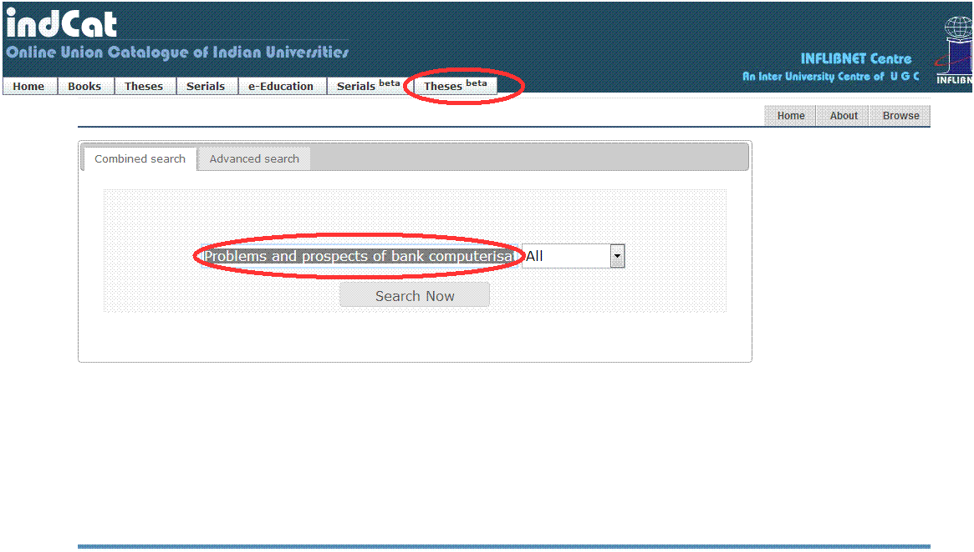
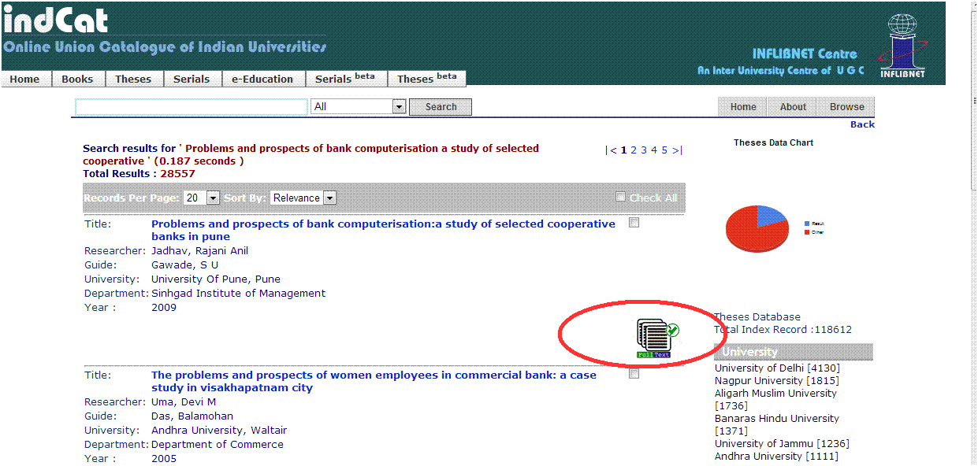
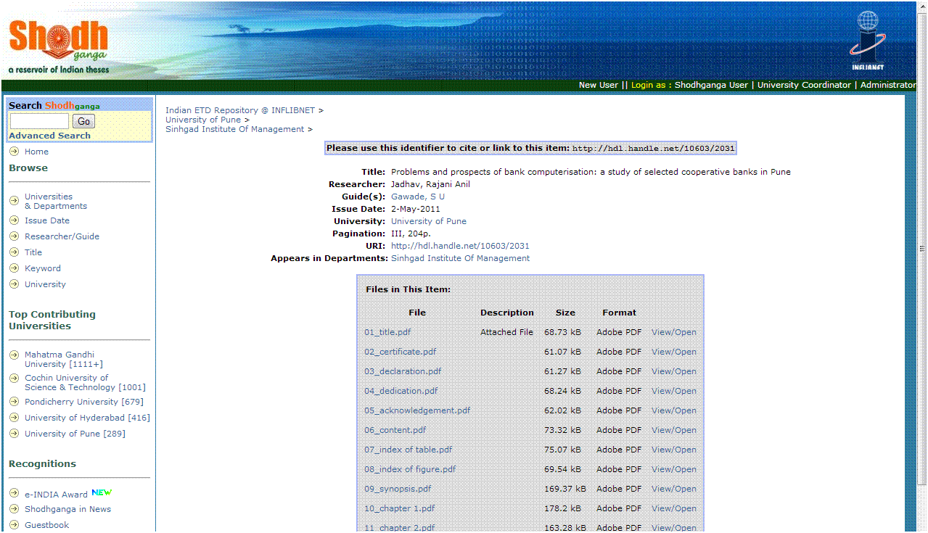
INDCAT integration with SHODHGANGA for Full text theses redirection
Showing full text availability
Redirecting to Shodhganga

Slide 35
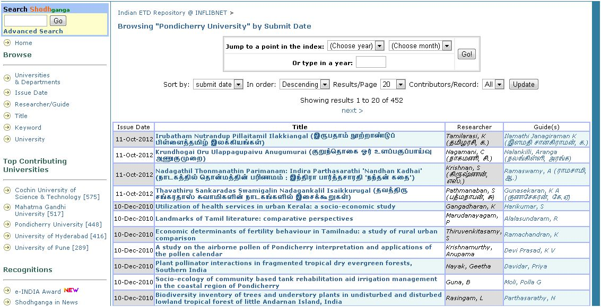
Theses Uploaded in Other Languages
In Tamil
Notes:
35

Slide 36
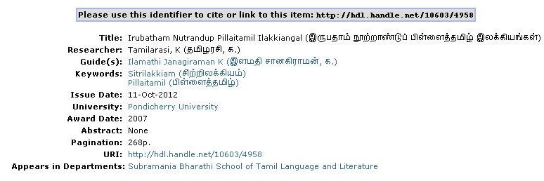
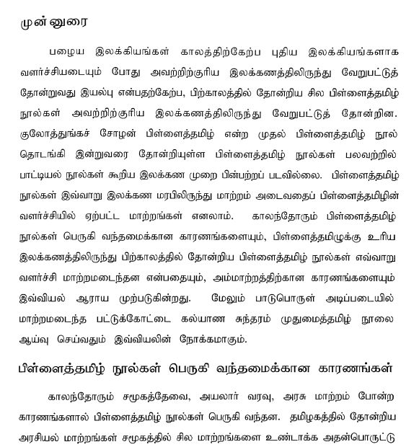
In Tamil
Notes:
36

Slide 37
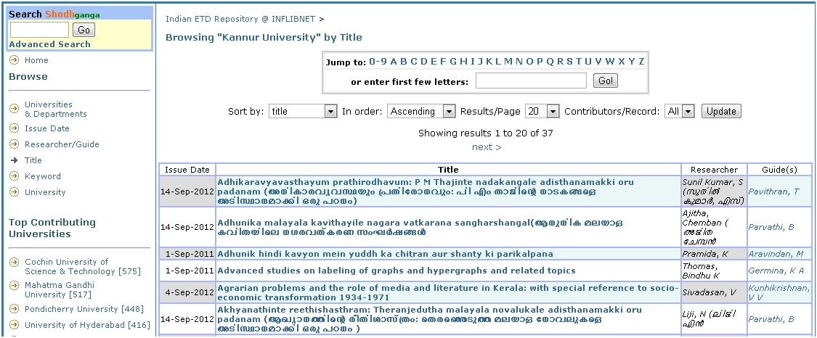
In Malayalam
Notes:
37

Slide 38
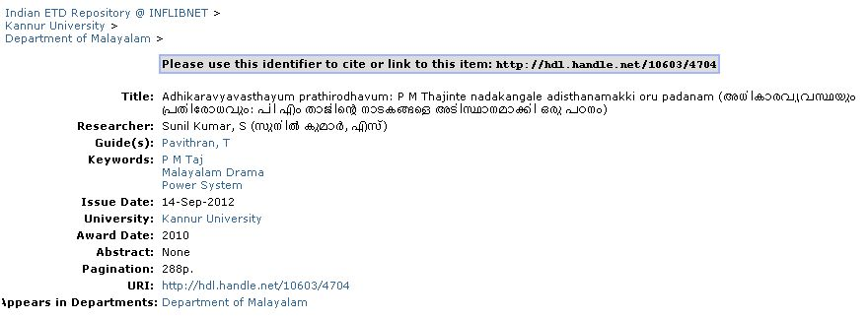
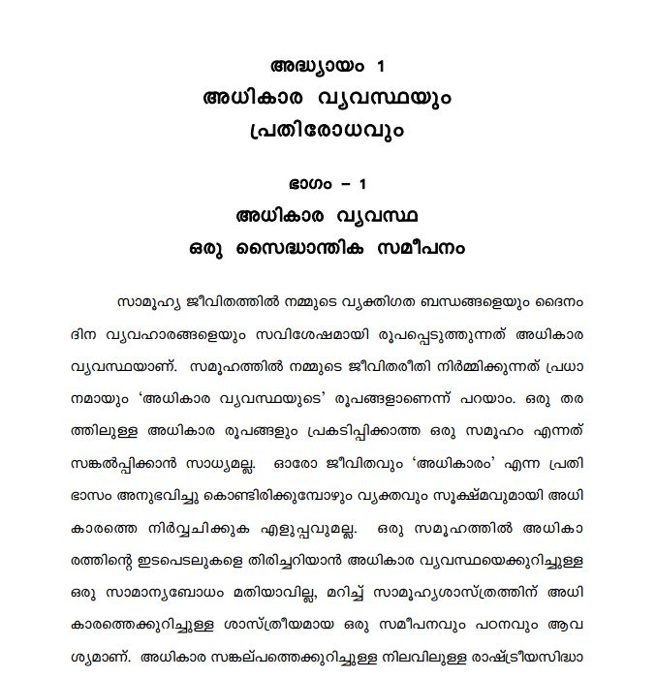
In Malayalam
Notes:
38

Slide 39
In Gujarati
Notes:
39

Slide 40
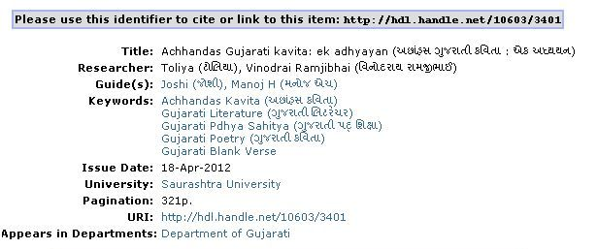
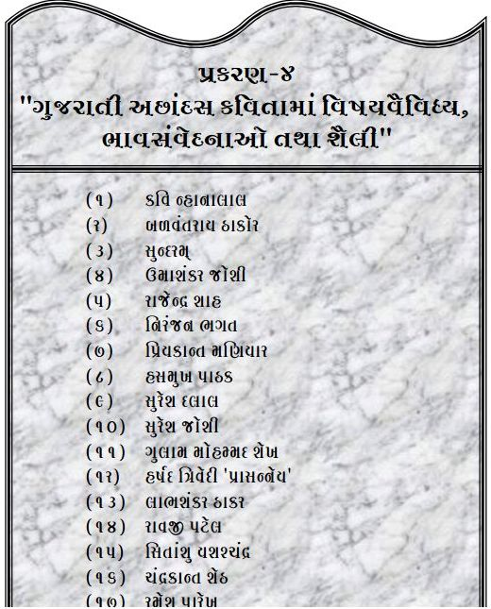
In Gujarati
Notes:
40

Slide 41
Ref: Kumar, Manoj, and Jagdish Arora. 2015. “Shodhganga and Deterring Plagiarism in Research Outputs in Indian Universities.” Proceeding Journal 10th International CALIBER 2015 , 524–533. http://ir.inflibnet.ac.in/1904/54.pdf

Slide 42
Research Ethics
Anti Plagiarism Software
Creativity
M
A
N
O
J
K
U
M
A
R
K
1
Research Ethics
2
Quality Writing
3
Plagiarism and Consequences
dsasdsasdasd
4
Anti Plagiarism Software
5
Viper, Urkund, iTheticate, Turnitin etc.
manoj@inflibnet.ac.in

Slide 43
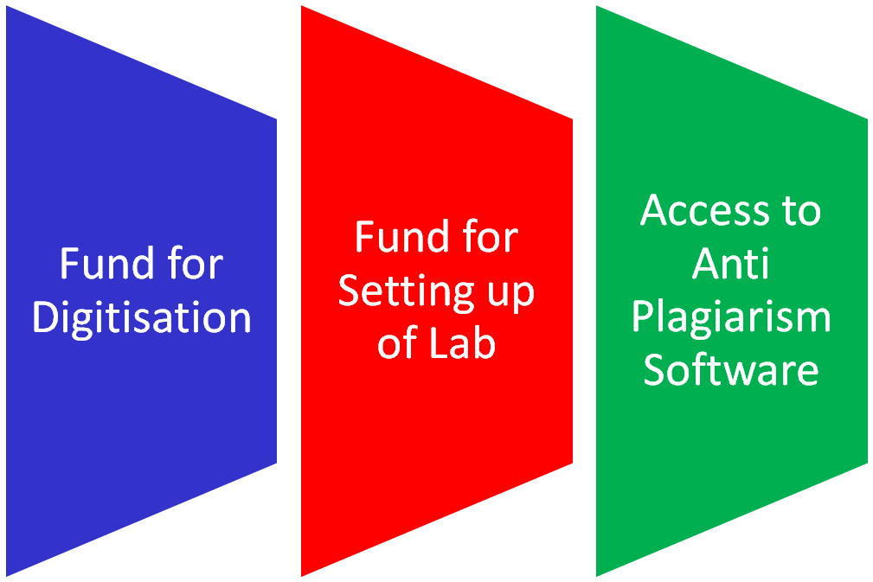
What Universities get on Signing MoU
Rs. 1 Lakh to 22 Lakhs/Uty
Rs. 5 Lakhs-
10 Lakhs/Uty
Rs. 1 Cr allocated
Rs. 6 Cr allocated
* Only 12 (B) Universities (provided to 100)

Slide 44
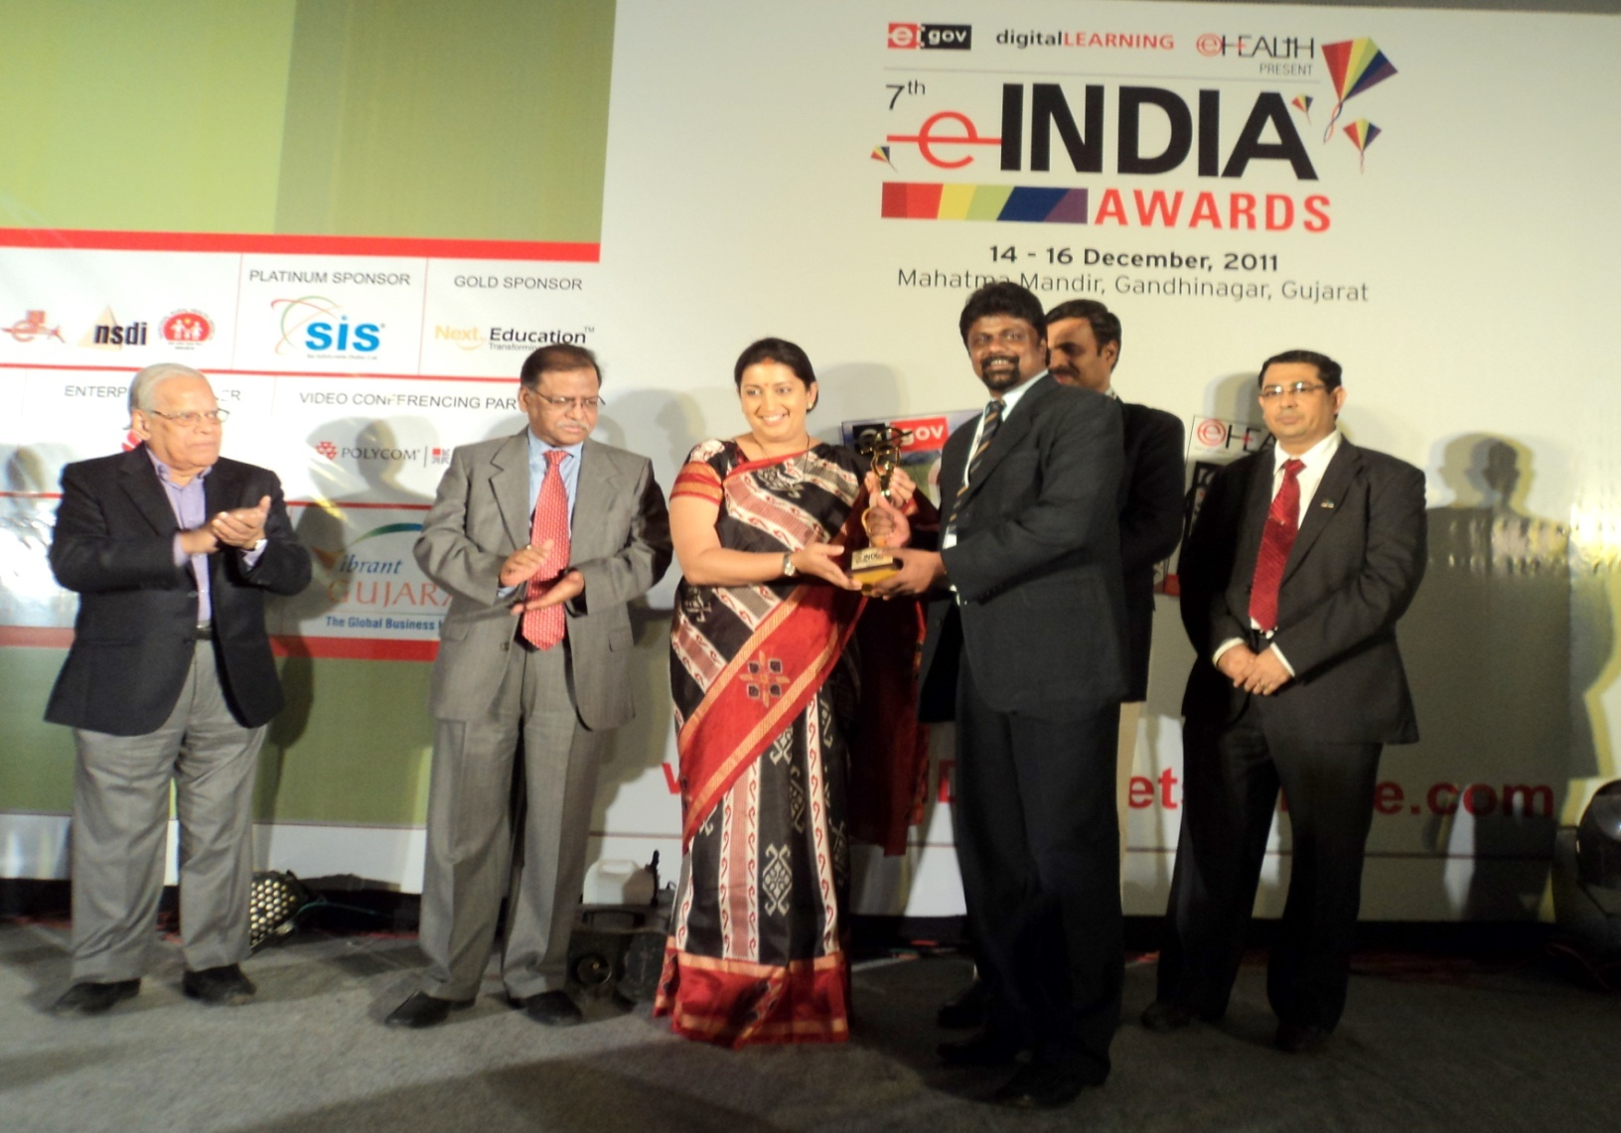
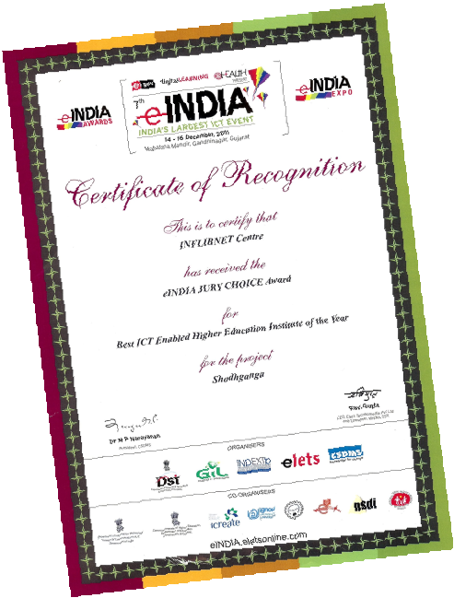
SHODHGANGA received Jury choice e-INDIA Award 2011
Now HRD Minister
Notes:
44

Slide 45
INFLIBNET Provided Two Anti Plagiarism Software during 2014-2015 to 100 Universities
By iParadigms
Founder: Dr. John M Barrie
iParadigms LLC
iParadigms founded in 1996

Slide 46
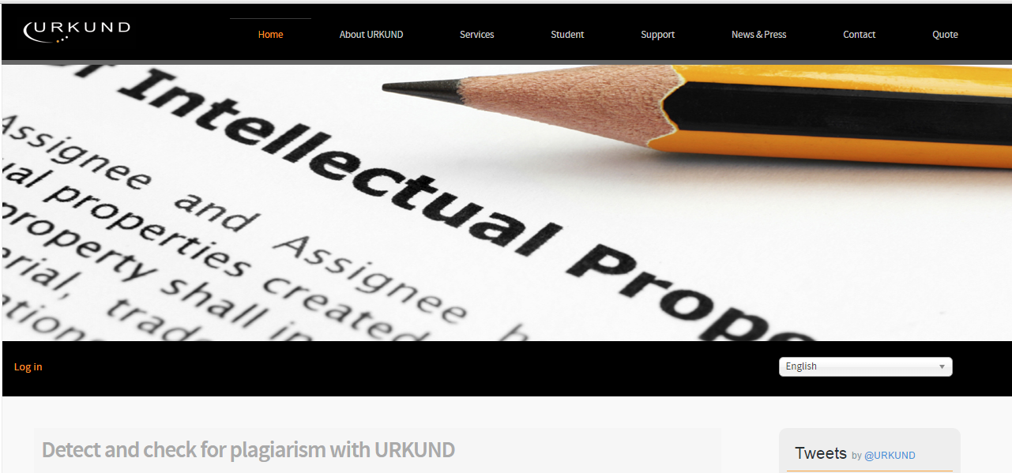
In 2015-16, Urkund Anti-Plagiarism provided to 145 Universities

Slide 47
What is Urkund ?
URKUND is a completely automated system against plagiarism and is being successfully used at universities
Note that URKUND never determines what is a plagiarism. The reports we provide to your teachers consist, in the event of us finding similarities, of a text comparison. We note the parts of your document that are similar to other sources, in URKUND’s archives, on the Internet and in published material, and give the teacher access to the original material where we have found the similarity. URKUND compares textual similarity and subject similarity.
Handbook
(http://static.urkund.com/manuals/URKUND_Plagiarism_Handbook_EN.pdf

Slide 48
Supports File formats
Characters Limit
Every document treated as a separate document.
Documents containing more than 400,000 characters will be considered as more than one document
so 800,001 characters would be 3 documents)

Slide 49
How to Login Urkund?
Click here to login

Slide 50
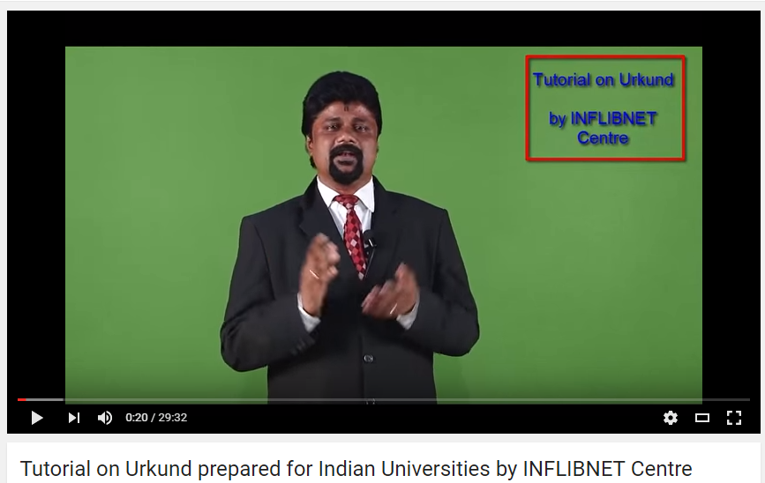
Video Tutorial Prepared
https://www.youtube.com/watch?v=goKHcO4JbGs

Slide 51
Urkund Dashboard

Slide 52
Issued guidelines to avoid Plagiarism
Attribute references
Describe all sources of information
Give acknowledgments
Provide footnotes
Use quotation marks wherever required
Paraphrase the original, attributed work
For extensive quotations, obtain permission from the publisher of the original work
Avoid self-plagiarism by taking permission from the publisher of the previous article authored by you
Obtain permission for use of published drawings or other illustrations

Slide 53
Punishments
Plagiarism may result in serious sanctions, including
Public disclosure,
Loss of research funding,
Loss of professional stature and
Termination of employment
Legal action against the individual's committing plagiarism

Slide 54
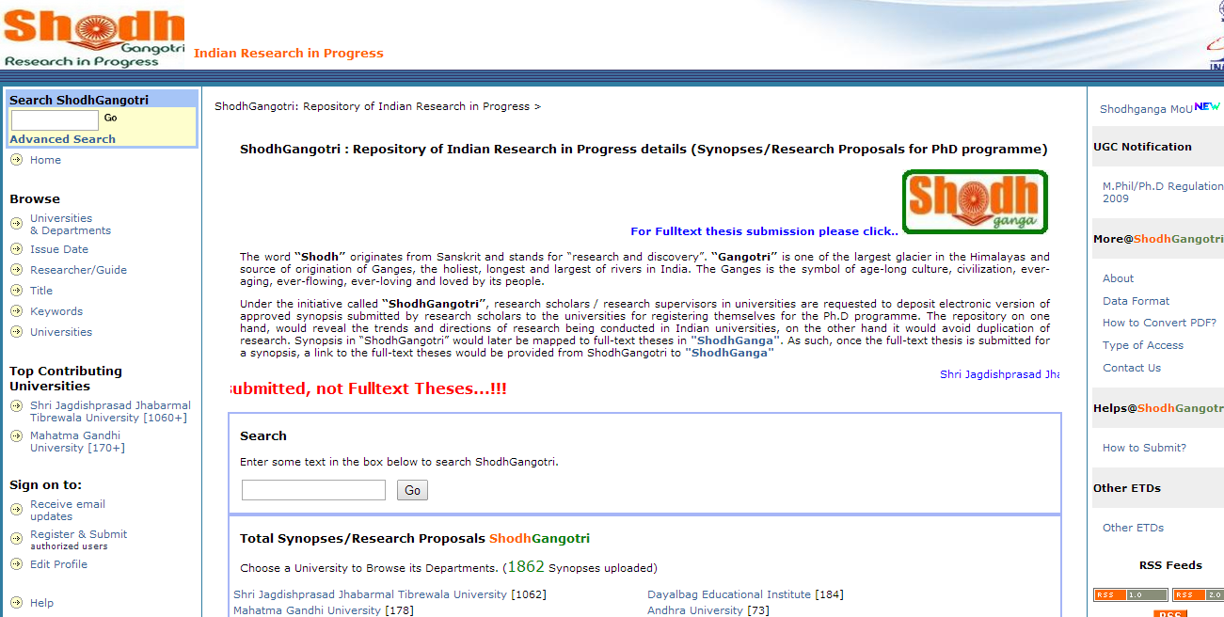
SHODHGANGOTRI Homepage at http://shodhgangotri.inflibnet.ac.in
3488+ Synopses
Notes:
54

Slide 55
Research Proposals/ Approved Synopses
Voluntary Submission by Research Scholars
2222 Synopses Uploaded

Slide 56
Research
Shodh Gangotri
Research in Progress

Slide 57
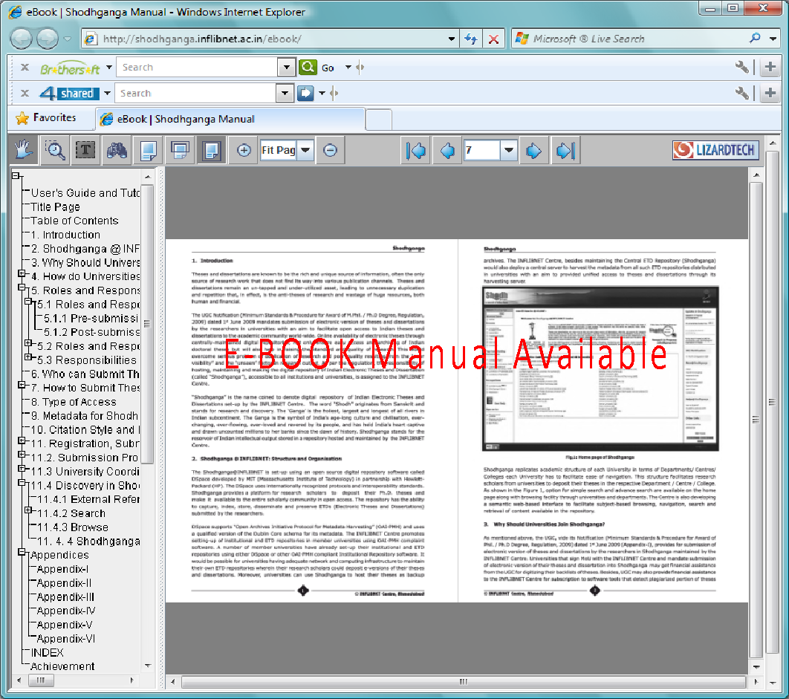
Visit for User Manual
http://shodhganga.inflibnet.ac.in/ebook/

Slide 58
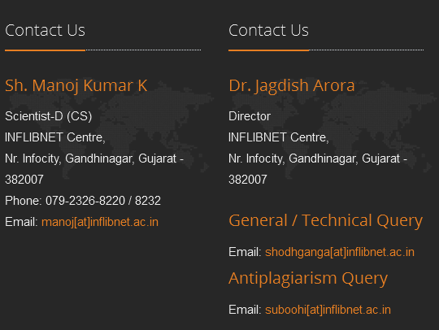
Thank You

