Slide 1
Ontology Libraries: A Study from Ontofier and Ontologist Perspectives
Debashis Naskar¹ and Biswanath Dutta²
DSIC, Universitat Politècnica de València¹
DRTC, Indian Statistical Institute²

Slide 2
Outline
Introduction
Classification of the Ontology Libraries
By types
By type of contents
Discussion of ontology libraries
Evaluation of the Ontology Libraries
Evaluation criteria
Comparative analysis
Conclusion

Slide 3
Introduction
Digital library
Ontology library
Digital Library and Ontology Library
Principally both a digital library and an ontology library have the similar kinds of purposes and objectives to achieve (e.g., store, organize and provide access to the digital objects), except the kind of materials they deal with.
A digital library deals with the documents of various types, such as text, audio, video, images, etc., while an ontology library deals with the ontologies (where an ontology is an intelligent object, often referred as a digital artifact, consisted of representations of the entities in terms of their types, properties and the relationships of a domain of discourse).
Purpose of the current work
To make a comparative analysis of the existing and popular ontology libraries based on a selected set of features.
Objective
To make aware the about the current state of the ontology libraries.

Slide 4
What is Ontology Library
Ontology libraries are the systems or platform where various types of ontologies are stored from different sources and provide the ability to data providers and application developers to share and reuse the ontologies.

Slide 5
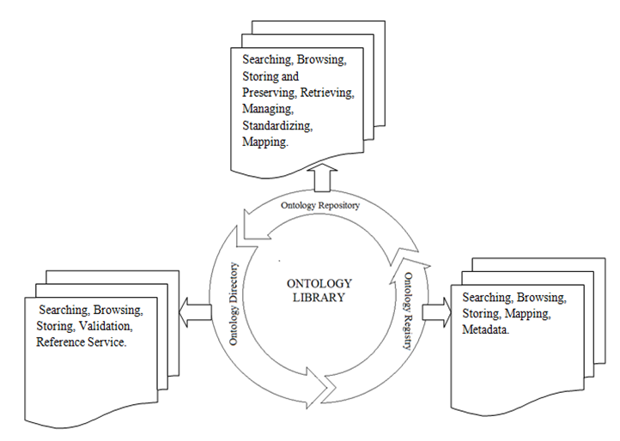
Classification of Ontology Libraries
Different forms of the ontology libraries:
Ontology Repository (OR)
Ontology Directory (OD)
Ontology Registry (OReg.)

Slide 6
Ontology Repository (OR)
An ontology repository is a facility where ontologies and related information (e.g., ontology metadata including the information on who included the ontologies) are stored, managed and retrieved .
The purpose of ontology repository is to enable users to upload, browse, search, share and manage the ontologies.

Slide 7
Ontology Directory (OD)
Ontology directory is a service that provides the information about ontologies that are available in a particular platform.
Ontology directory contains the reference to the definition of ontology related language based schema such as OWL, XML, and RDF Schema. It provides metadata and source of information.
It follows simple hierarchical structures, which is effective in data storage and classification.

Slide 8
Ontology Registry (OReg.)
A registry provides a data storage interface where data, knowledge, metadata of a semantic object including the name of the person or any community and process of using data are registered.
It can be defined as a platform where list of metadata can be declared for visualizing data, storing information and access the knowledge about domain, scientific elements.
An ontology registry consists of a list of ontologies and metadata instead of consisting the actual set of ontologies.

Slide 9
Classification of Ontology Libraries based on type of contents

Slide 10
Examples of ontology libraries

Slide 11
Evaluation of the Ontology libraries
Target: to make a comparative analysis of the existing and popular ontology libraries.
To do the analysis, we have identified the following characteristics.
Specialization or field
Browsing and searching ontologies
Submission process of ontology
Mapping and relations
Web service protocol(API)
Usage and access of ontology
File format for input and output
Technology and interface

Slide 12
 | BioPortal | AgroPortal | COLORE | ROMULUS | OeGOV | ODP | ONKI | DAML OL | MMI-ORR | Protégé OL
Specialization | Biomedical | Agronomic | General | Mixed | e-Government | General | Mixed | Mixed | Domain | Mixed
Browsing and Searching ontologies | YES | YES | No support | YES | No support | No support | YES | YES | YES | YES
Submission process of ontology | Registered users | Registered users | Administrators and Registered users | Administrators | Administrators via blog post | Registered users | Administrators | Organization and any users | Registered users or organization | Registered users
Mapping and Relations | Mapping between classes | Mappings between ontologies | Mappings between modules | Mappings between ontologies | No support | N-ary Relation | No support | No support | Mapping across vocabularies | Mapping between ontologies
Web Service Access (APIs) | REST | REST | REST | REST | No support | No support | REST | JENA | REST | REST
Usage and Access of Ontology | Upload, Edit and Download | Upload, download | View and Download | View and Download | List of Ontologies description & View | Design ontology for pattern reuse & View | Access general ontology, Upload, Download & View | Access and View | View, Upload, Print and Download | View and Download
File Format for Input and Output | OWL, RDF, OBO, RRF | OBO, RDF, OWL | XML, CLIF | OWL DL, OWL 2DL, OBO | OWL, RDF, N3 | OWL | RDF | RDF, DAML + OIL, OWL | OWL, RDF/XML, N3, JSON, CSV | OWL, DAML+OIL, RDFS
Technology and Interface | Protégé, LexGrid | Protégé, Web-Protégé | Samian Platform | WebProtégé | Wordpress | MediaWiki | Ad-hoc | Protégé | Voc2RDF | Protégé

Slide 13
Conclusion
The exact and precise requirement for building Ontology and Ontology libraries is essential to amalgamate and compile the vast pool of knowledge into a unified platform. It seeks to find the connections between various areas of such a compilation of knowledge.
In the current study, we have classified the ontology libraries into three types: ontology repository, ontology directory and ontology registry.
The libraries primarily consists of general, domain and mixed kinds of ontologies.
In the current study, we have studied and critically analysed the ontology libraries against a set of parameters.
In the future, we would like to extend this work by studying the libraries with more advanced features, such as, pictography document, community service, interface, etc.

