Slide 1
Surveying ETD Infrastructure Needs: From Author to End User
Megan Sheffield
E-Science Librarian
Clemson University Libraries
msheff@clemson.edu
Andrew Wesolek
Head of Digital Scholarship
Clemson University Libraries
awesole@clemson.edu

Slide 2
Clemson at a Glance:
Land Grant institution for SC
Science and Engineering orientation
Enrollment of nearly 23,000:
18,000 undergraduate
5,000 graduate
Cooper Library at a glance:
28 Faculty
62 Staff
76 student assistants
Traditionally focused on outreach and instruction
Notes:
2

Slide 3
Data Management Services at Clemson
2012:
Environmental scan uncovered data management practices and needs
Development of LibGuide: http://libguides.clemson.edu/datamanagement
2013:
Hired E-Science Librarian & Head of Digital Scholarship
Joined the U. California DMP Tool
Launched bepress Digital Commons institutional repository, TigerPrints
2014-Present
Formed CU Data management team (Libraries, Sponsored Programs, CCIT)
Conducted internal and external trainings on data management planning
Continued to develop Data Management Libguide

Slide 4
Graduate students’ data sharing practices

Slide 5
Largest amount of data for a single project?
Response Percentage
Less than 1GB 27%
1 GB to 100 GB 35%
100GB to 1 TB 11%
1 TB to 100 TB 6%
100 TB to 1 PB 0%
>1 PB 0%
I don’t know 21%

Slide 6
Have you ever cited a data set in your research?

Slide 7
How do you make your data available?

Slide 8
What keeps graduate students from sharing their data?

Slide 9
Remaining mindful of our end users

Slide 10
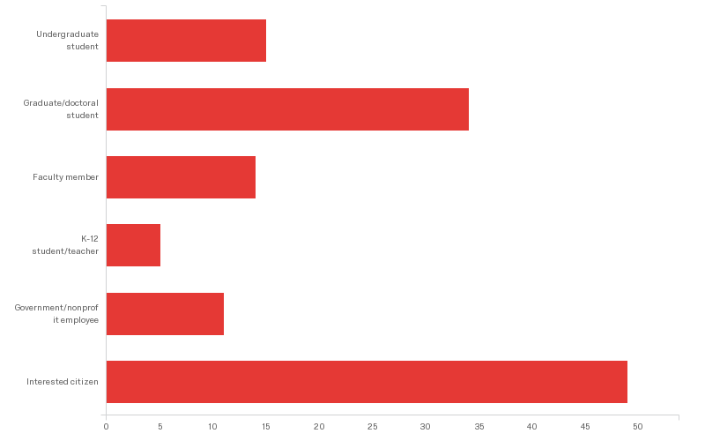
What is your primary role?
Response Percentage
Undergraduate Student 11.72%
Graduate/Doctoral Student 26.56%
Faculty Member 10.94%
K-12 student/teacher 3.91%
Government/Nonprofit 8.59%
employee
Interested Citizen 38.28%

Slide 11
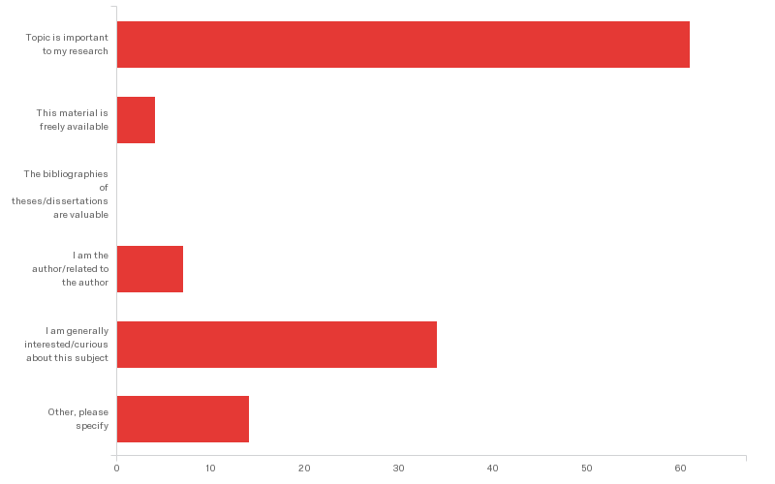
What best describes the reason you are downloading this thesis/dissertation?
Response Percentage
This material is important 50.83%
to my research
This material is freely available 3.33%
The bibliographies are valuable 0.00%
I am the author/ 5.83%
related to the author
I am generally interested 28.33%
Other 11.67%
Notes:
the work cites my work
I am a librarian trying to get to the bottom of metadata inconsistencies in ETD data.
Genealogy of family members
I am compiling a list of dissertations for the Astronomy Genealogy Project (http://had.aas.org/astrogen/).
verifying information about author
Researching IRs
History of former pastors
not sure yet if it is relevant want to see references at end
I'm generally curious but especially, the Google "snip" from article made it seem like this text is Readable by a layperson.

Slide 12
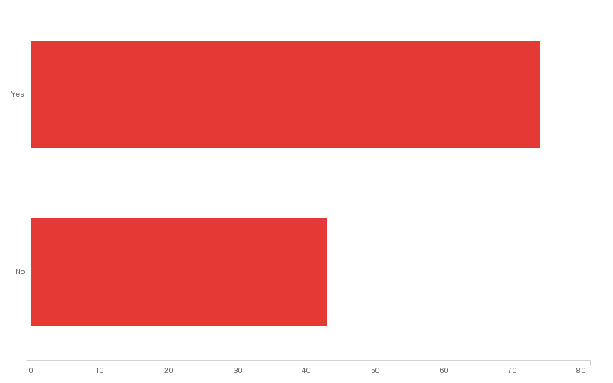
Prior to downloading this work, were you aware that it was a thesis/dissertation?
Response Percentage
Yes 63.25%
No 36.75%

Slide 13
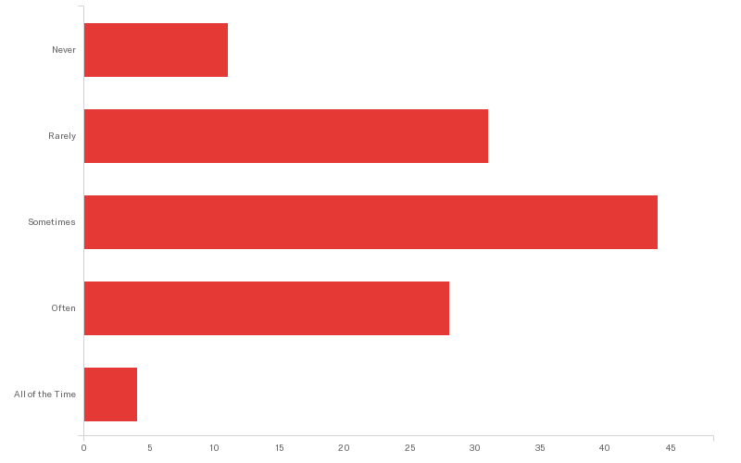
How frequently do you use theses/dissertations in your research?
Response Percentage
Never 9.32%
Rarely 26.27%
Sometimes 37.29%
Often 23.73%
All of the Time 3.39%

Slide 14
Country of Origin
Notes:
58% from US
6% India
4% from Germany
4% from Malaysia
Then, very long tail of low usage

Slide 15
Take Away
As we continue to develop data management services and infrastructure, we must do so in ways that ensure accessibility for all of our end users.

