Slide 1
Dissertations as Data
Joachim Schöpfel, Eric Kergosien, Stéphane Chaudiron, Bernard Jacquemin
GERiiCO laboratory, University of Lille (France)

Slide 2
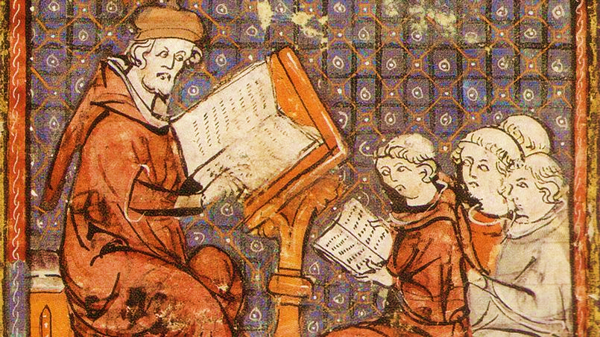
Notes:
Cours de philosophie à Paris, Grandes chroniques de France (fin XIVe), Castres bibliothèque municipale, domaine public

Slide 3
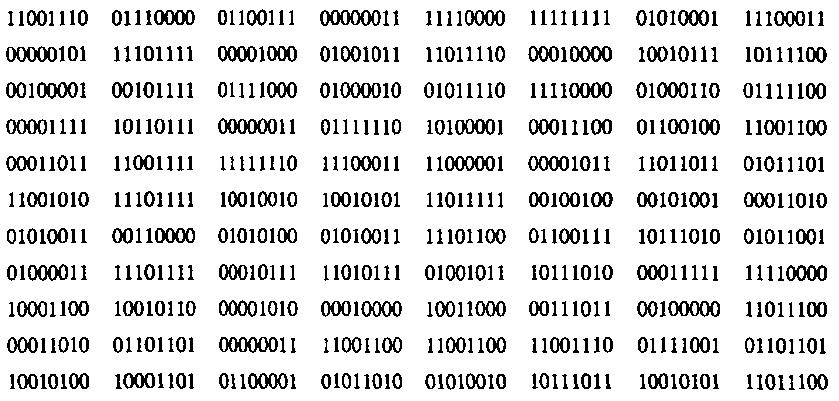

Slide 4
Overview
Conceptual approach and empirical application
About dissertations
Dissertations and data
Dissertations as data
Examples
Barriers
Concluding remarks

Slide 5
About dissertations
Three ways to describe a dissertation

Slide 6
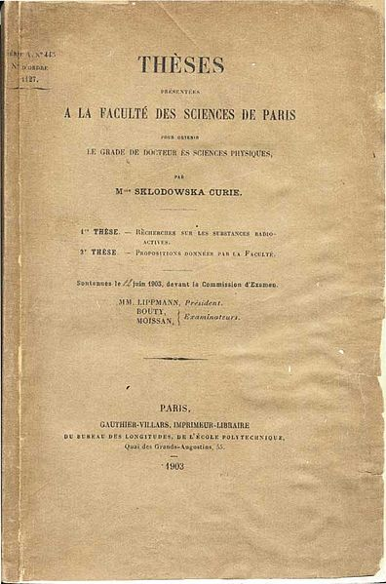
Dissertation as a document
document
form
sign
medium
Source: RTD-DOC, CNRS 2003-2006

Slide 7
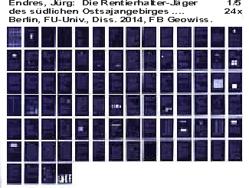
Dissertation as a form
form
= an object whose materiality allows the users to use it and to manipulate it
Format
Media
Structure
Figures
References
Annexes, other material

Slide 8
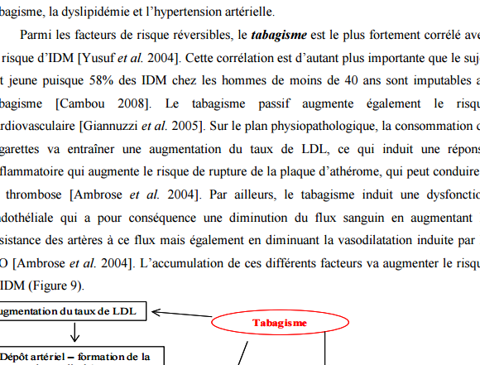
Dissertation as a sign
sign
= content, a semantic network of information, part of a collection
Terminology
Semantics
Relevance
Context of interpretation
Knowledge

Slide 9
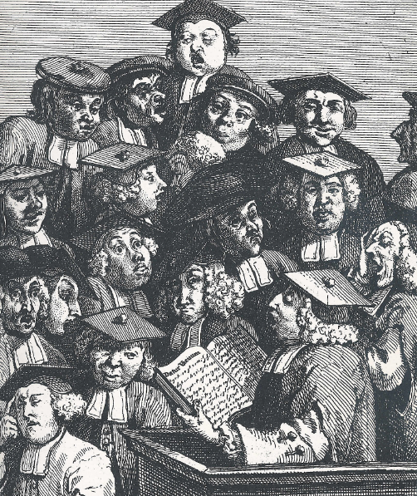
Dissertation as a medium
medium
= a trace of social activities, a tangible element of communication between human beings, a social phenomenon
Institutional character (legitimacy)
Prescription (format, content…)
Legal and administrative status
Process (deposit, preservation, dissemination…)
Research project (scientificity)
Evaluation (impact)
Network (altmetrics)
Open science (outreach)
Creative work (authorship)
Intellectual property
Competitive strategy (career)
Financial interests (publication, patent…)

Slide 10
Dissertations and data
A reminder

Slide 11
Data vehicle
Dissertations contain data
Primary data (sources)
Secondary data (results)
In the text
Figures
Tables
In appendix
Various formats, often non compliant with content mining
More or less structured
Sometimes on different medium
No identifiers
Metadata?

Slide 12
Data in PhD dissertations (survey 2015, N=780)
Databases
Experimental results
Surveys
Maps
Archives
Photos videos sounds
Graphs
Codes

Slide 13
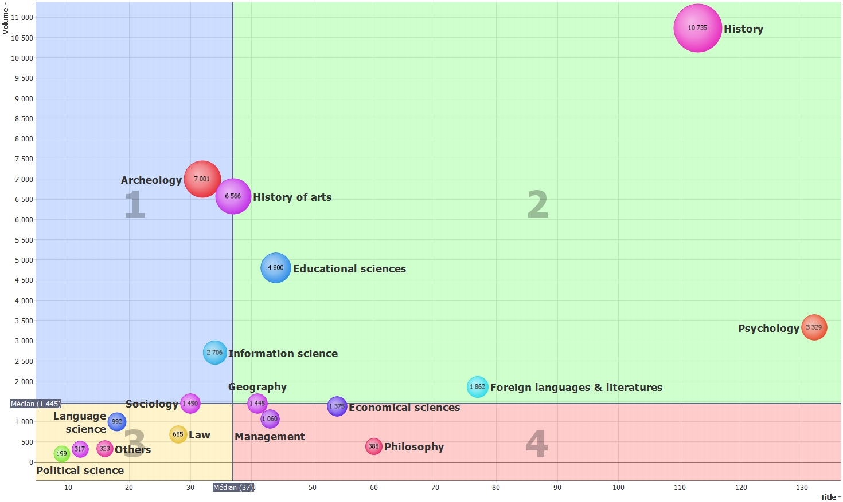
Data in PhD dissertations (survey 2015, N=780)

Slide 14
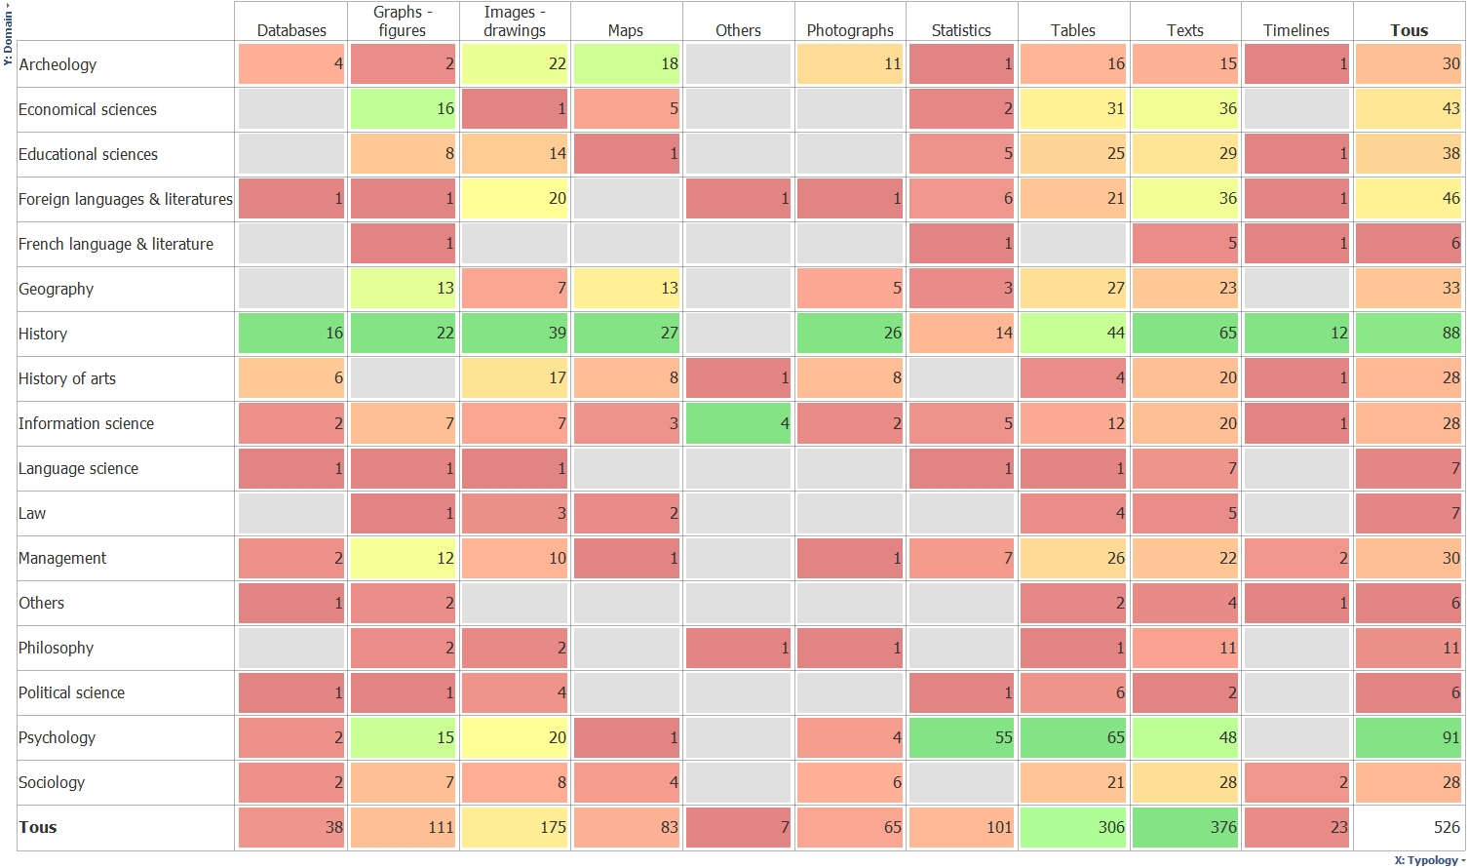
Data in PhD dissertations (survey 2015, N=780)
Total
Total

Slide 15
Gateway to data
Dissertations (can) link to data
Primary data (sources)
Secondary data (results)
Where is the data?
In data repositories
In institutional repositories
In social networks, …
Format
Initial (production), preservation, dissemination
More or less structured
Metadata
Identifiers (DOI)
Generic v disciplinary

Slide 16
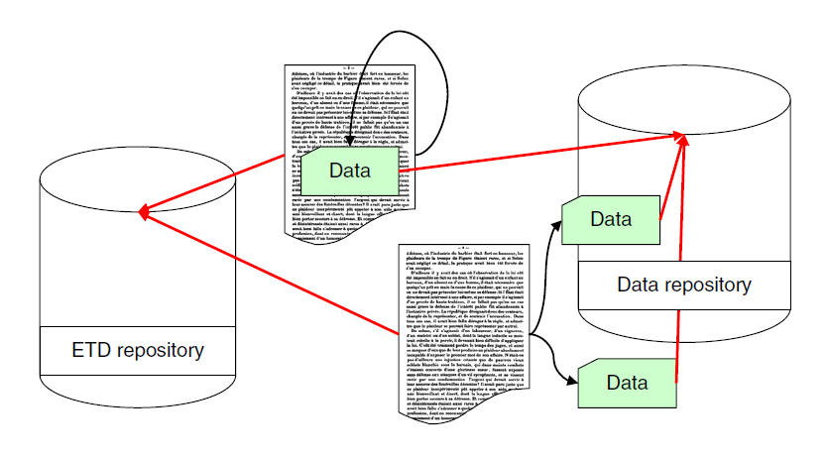
Separation of text and data

Slide 17
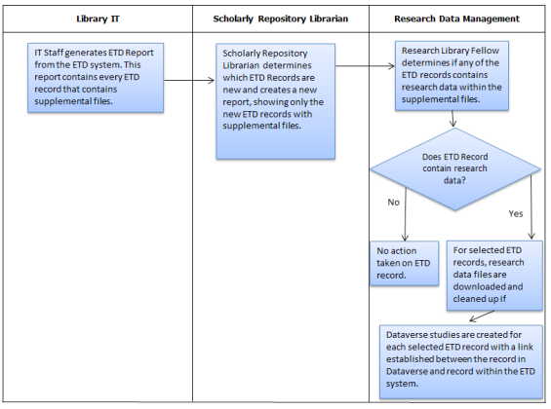
Workflow – Dataverse ETD Pilot Program
Metadata
Documentation
Identifier
Link
Source: Dataverse ETD Pilot Program at Emory (Doty et al. 2015)

Slide 18
Workflow – ETDplus project (Educopia Institute)
Separation of the dissertation text files and the related “complex content objects” whenever possible.
“Embedding multimedia components within the full text might seem advantageous in that they would then be inseparable. However, when the time comes that it is necessary to migrate either the full text itself or one of the multimedia components, having separate files would greatly simplify matters” (p.5-9).
Metadata and persistent identifiers like handle, PURL, ARK or DOI are supposed to provide the “glue” that binds together the text, multimedia and data files.
Preservation-worthy research data (survey data, measurements, laboratory notebooks, measured spectra etc.) might be stored as part of an “ETD package” or, after transformation into archival files, in a separate data repository, and “links to the data repository from the ETD metadata would then enable researchers to access these research data in the future” (p5-11).
Source: Guidance Documents for Lifecycle Management of ETDs (Schultz et al. 2014)

Slide 19
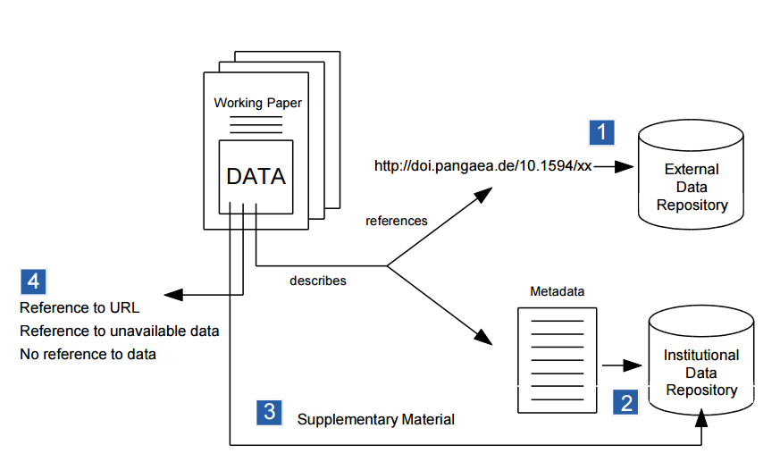
Workflow – Bielefeld PUB
For working papers but also for ETDs
Research data as a discrete resource
Attribution of DOI (DataCite)
Distinction between institutional and disciplinary data repositories
Source: Bielefeld PUB (Schirrwagen & Vompras 2015)

Slide 20
Dissertations as data
Another way to see and handle dissertations

Slide 21
Data
No distinction between text and data
The whole dissertation is data
set of values of qualitative or quantitative variables
some existing information or knowledge represented in some form suitable for better usage or processing
can be measured, collected and reported, and analyzed, to create information suitable for making decisions
Distinction between data and metadata
Yet, metadata is data, too

Slide 22
From print to … digital
form
structure
data
sign
structured data
knowledge
medium
data
procedure
form
medium
inscription
sign
content
meaning
medium
inscription
legitimacy

Slide 23
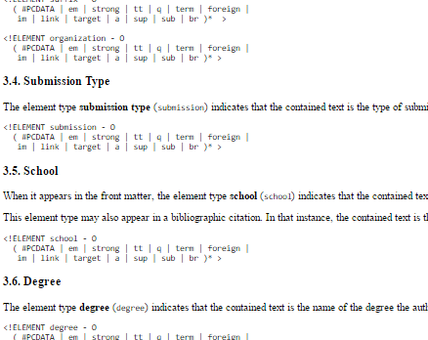
ETD as a
form
= structure + data; allows for information extraction and filtering
Format: XML (syntax)
Media: Web
Structure: DTD
Text encoding: TEI (grammar)
Resource Description Framework
Metadata
http://etd.vt.edu/etd-ml/dtdetds.htm

Slide 24
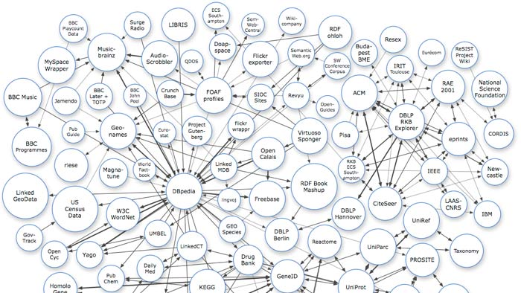
ETD as a
sign
= structured data + knowledge; aboutness, intentionality
Semantics
Ontologies
Vocabulary
Wikipedia
Geolocation
Research information
http://davemeeker.com/wp-content/uploads/2008/04/semanticweb.jpg

Slide 25
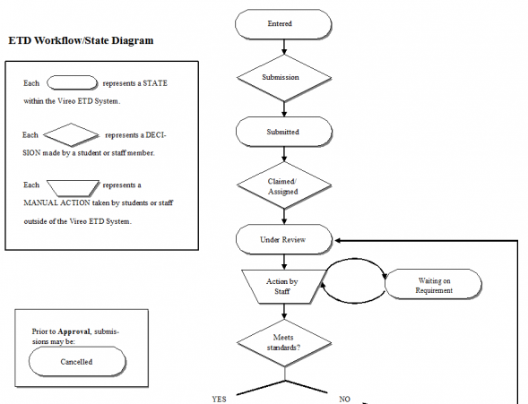
ETD as a
medium
= data + procedure
Rules (prescription)
Format
Structure
Legal status
IP exception
Licensing
Access restrictions
https://wikis.tdl.org/tdl/ETD_Workflow_Diagram

Slide 26
Examples

Slide 27
Re-use to enable new insights from text and data
Text and data mining (TDM) or content mining of machine-readable text and data
Extraction of information (knowledge) from large volume of content
“The main barriers against the uptake of TDM are not technical, but primarily a lack of awareness among academics, and a skills gap. They relate to legal issues around copyright and database rights, and to some policy choices of restrictions being implemented by publishers on (for instance) access to APIs. These problems are all soluble, but require non-technical solutions.”
Brook, M., Murray-Rust, P., Oppenheim, C., Nov. 2014. The social, political and legal aspects of text and data mining (TDM). D-Lib Magazine 20 (11/12). http://dx.doi.org/10.1045/november14-brook

Slide 28
SPECTRa-T – a JISC project 2007-2008
A proof-of-concept approach focusing on chemistry research data in molecular and related subjects
To develop text-mining tools and processes for the automatic extraction of experimental research data (chemical objects and named chemical entities)
To transform the extracted data into metadata and ingest them into data repositories and RDF triplestores, thus enabling RDF-based semantic querying of the contents
Morgan, P., Downing, J., Murray-Rust, P., Stewart, D., Tonge, A., Townsend, J., Rzepa, H., 2008. Extracting and re-using research data from chemistry e-theses: the SPECTRa-t project. In: ETD 2008 11th International Symposium on Electronic Theses and Dissertations, 4 - 7 June 2008, The Robert Gordon University, Aberdeen, UK.

Slide 29
SPECTRa-T workflow
Various ETD formats – LaTeX, Postscript, Adobe Portable Document Format (PDF), Microsoft Word (DOC),
Microsoft Office Open XML (DOCX)
http://www.dspace.cam.ac.uk/handle/1810/230116

Slide 30
SPECTRa-T on ETDs as
form
“PDF (…) is significantly less well-suited to text-mining than is marked-up text.”
“For data mining in chemistry, a marked-up document file format (such as Office Open XML) for deposited e-theses should be available in preference to PDF.”
“Require deposit of the Word version of the thesis, and then to convert it to XML as a standard process (…)”

Slide 31
SPECTRa-T on ETDs as
sign
“Discipline-specific text-mining tools, together with the triplestore and data repositories into which text-mined outputs are to be deposited, will best be managed by subject experts operating within the same disciplinary environment.”
“Much of the effort involved in developing text-mining tools and workflows is unavoidably specific to individual disciplines.”
“Those who are responsible for designing and delivering institutional repository services need to work closely with researchers in different subjects, in order to understand their needs and co-ordinate departmental and institutional activities.”

Slide 32
SPECTRa-T on ETDs as
medium
“Institutions to determine what purpose theses might serve in each discipline beyond their immediate role in assessing a student's research (…)”
“In the sciences theses should be regarded not simply as objects destined for preservation and archival status, but rather as unique resources containing potentially valuable data that must be made extractable and re-usable.”
“Those authorities with responsibility for overseeing the writing, submission and subsequent management of theses (should) implement appropriate strategies, applying both institution-wide and discipline-specific policies, guidelines and practices designed to ensure optimal conditions for re-use. In other words, institutional regulations should ensure that each thesis is fit for purpose.”

Slide 33
Lille project
TERRE-ISTEX project for geographic indexing and analysis
from scientific corpora
Thematic project (funded by ISTEX 2016 – 2017)

Slide 34
Lille : ISTEX project
1 objective: To offer an unique and exceptional concentration of scientific documentation archives
2 parts: acquisition of scientific digital archives, creation of the ISTEX platform
3 level of services: basic services, value added services, thematic projects
5 partners (+): CNRS, ABES, Couperin, MESR, Université de Lorraine for engineering CPU (+ R&D)
Budget: 60m € (« Investissements d’Avenir »)
Duration: 3 years
http://www.istex.fr/

Slide 35
Lille : Issues
To study what happens on a territory on the thematic « climate change » from heterogeneous scientific data (scientific articles from CIRAD and ISTEX, PHD Thesis)
To give an help to Scientists to do their state-of-the-art (on a territory, on a thematic…)
Questions :
What is a territory ? → A set of geographical information
Geographical information = spatial entity (where) + thematic entity (what) + temporal entity (when)
Example : a study on climate changes realized in the south of Madagascar in 1981.
How to identify this kind of information? → text mining methods in abstract and content, experts validation
A use case for research information:
What are the scientific documents related to Madagascar and Sénégal?
In these documents, what are the studied thematics and the associated authors?
→ Development of a Geographical Research Tool based on Elastic Search
→ Spatial visualization
→ the results analysis is made by experts

Slide 36
Lille : Data
CIRAD data
Multilingual data Données coming from the Agrotrop database: CIRAD open archives
92 000 references and 25 000 complete documents: scientific publications and grey literature ( reports, etc.) 3000 documents related to the thematic « climate change »
Metadata : title, author, abstract, indexed labels coming from lexicons (AGROVOC thesaurus and Agris/Caris from the FAO. Thèmes Agris : https://agritrop.cirad.fr/view/subjects/, geographical information (countries)
PHD Thesis data (ANRT)
200,000 PhD theses, metadata, SUDOC link (ABES).
70,000 digital documents
ABES: RAMEAU thesaurus from the BnF for label description
400 PhD theses related to the thematic « climate changes »
ISTEX Data
8,190,000 scientific articles (Emerald, Wiley, Elsevier, etc.) related to the thematic « climate change » (10,000 are in french)
Metadata into MODS (XML format)

Slide 37
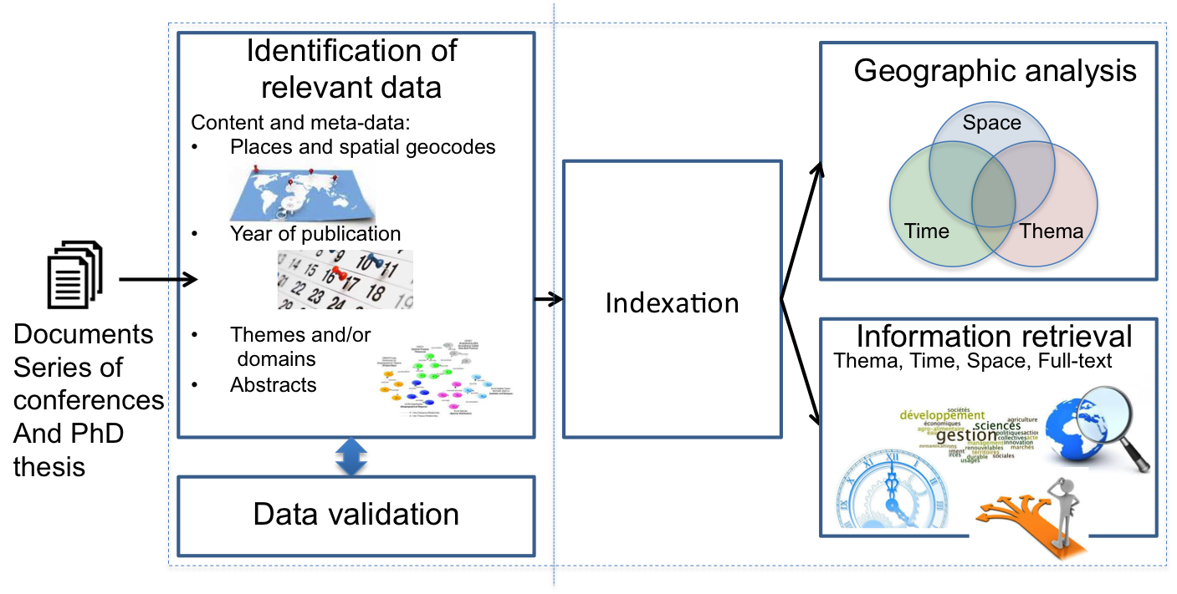
Lille : General process

Slide 38
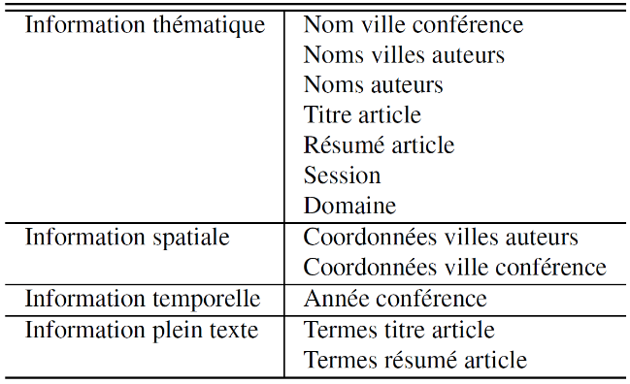
Lille : First work (proof of concepts)
Geographical analysis on the EGC conference publications (1200 articles): Indexing, Research information, Analysis
Build a first geographic index
(MODS model for metadata)
Implementation of a Multicriteria Reseach Information tool based on Elastic Search

Slide 39
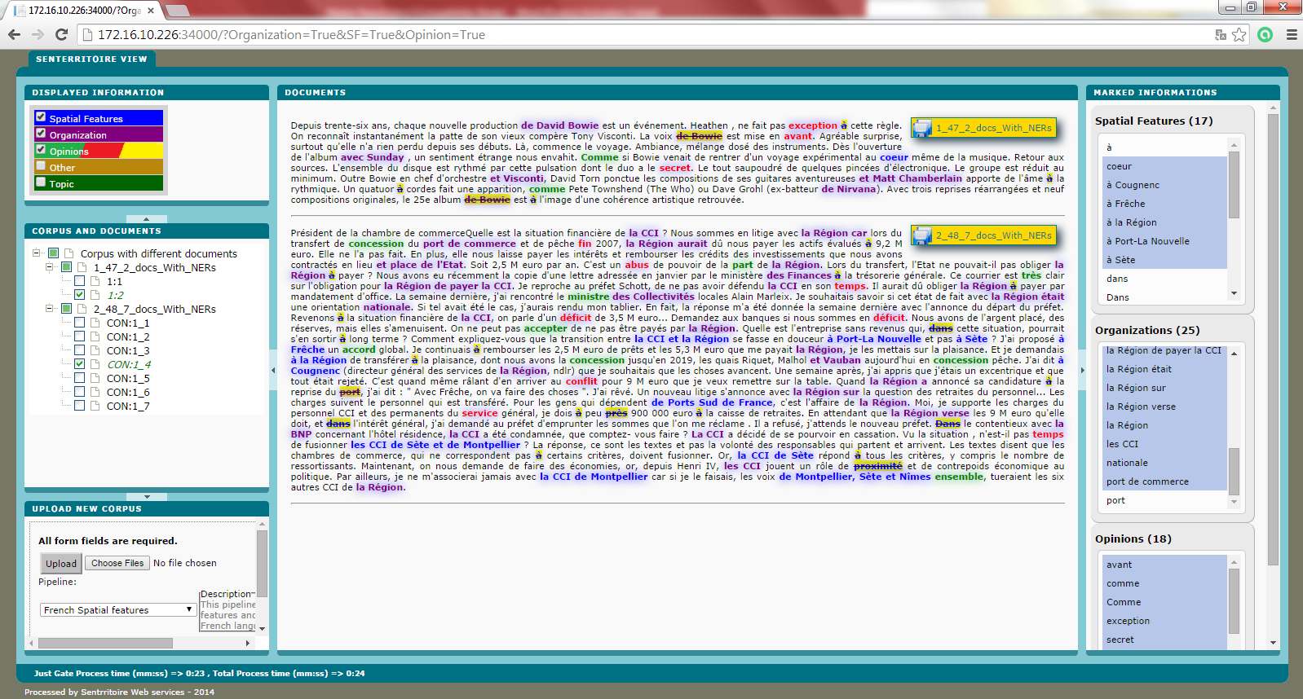
Lille : First work (proof of concepts)
The sentiAnnotator viewer for the extraction process and experts validation (ISWC, october 2015)
Upload of Big corpora (french and english)
NLP process to extract features
Experts can (un)validate marked
data
Possibility to download results
http://siso.teledetection.fr/

Slide 40
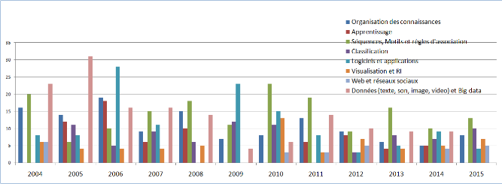
Lille : First work (proof of concepts)
Geographical analysis on the EGC conference publications: Indexing, Research information, Analysis
A set of geographical analysis available (in french language) : Elastic Search and Kibana tool
http://ekergosien.net/DefiEGC/index.html

Slide 41
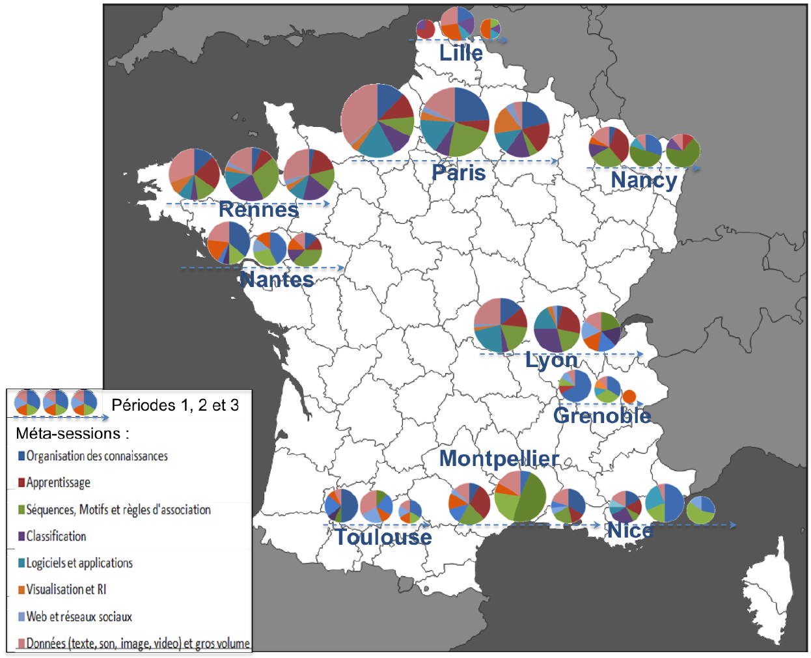
Lille : First work (proof of concepts)
A set of geographical analysis available : Elastic Search and Kibana tool

Slide 42
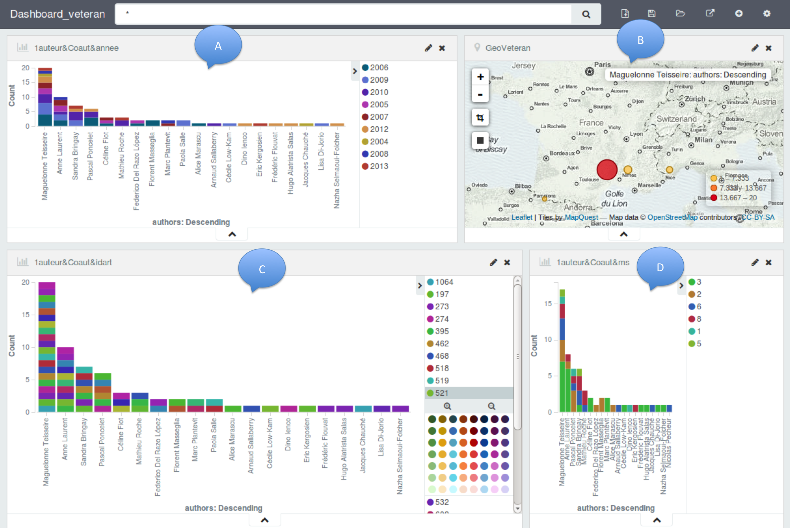
Lille : First work (proof of concepts)
A set of geographical analysis available

Slide 43
Lille
Prospects: « big data », Valorization
« Big data »
Heterogeneous data from ISTEX, PhD theses and Cirad corpus :
Normalization of medatada with the MODS model (XML)
Volume:
→ Test the scalability of our text mining application on bigger corpora
Tests on other thematics (history, technology, culture…)
Integrate other ressources (web, bases de données, archives ouvertes, plateformes…)

Slide 44
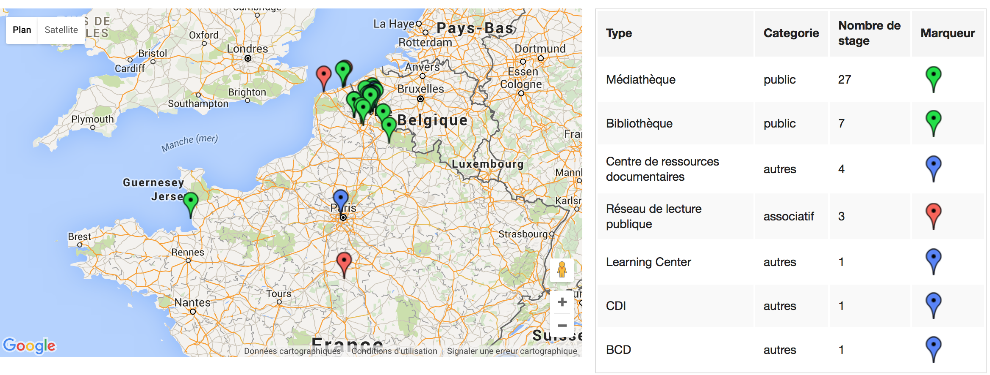
Master and BA dissertations
Indexing students disseratons (for Lille 3 students: thousands of dissertations)
Implementation of a dynamical geographical information research tool

Slide 45
Barriers

Slide 46
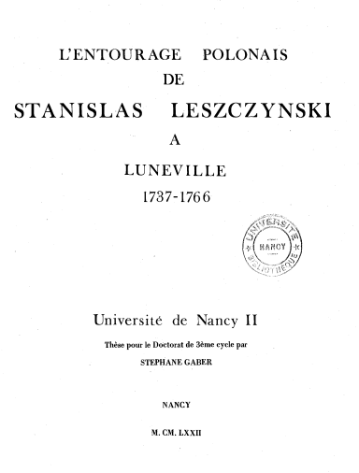
Availability
One part of dissertations is not digital
Especially older dissertations
Digitization of print dissertations: problem with OCR (see SPECTRa-T)
http://docnum.univ-lorraine.fr/public/BUL_T_1972_0006_GABER.pdf

Slide 47
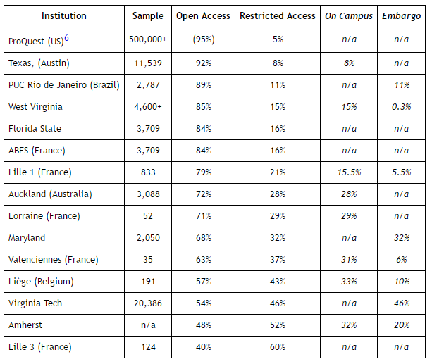
Accessibility
One part of dissertations is not online
And/or not (easily) identifiable
Some (few) are confidential
More are embargoed (publishing)
Others are restricted to on-campus access only
Social networks, private websites…
http://www.dlib.org/dlib/march15/schopfel/03schopfel.html

Slide 48
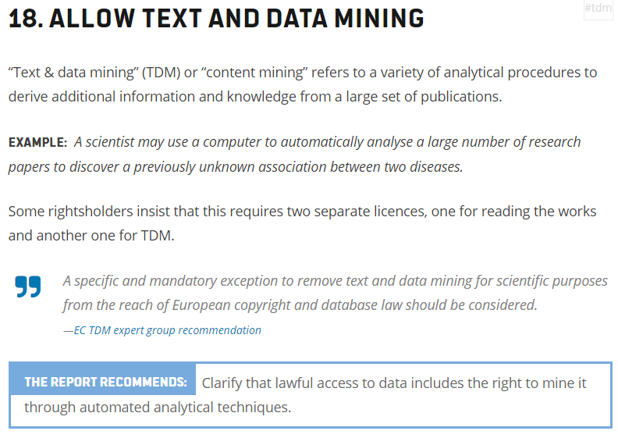
Legality
Dissertations are online but TDM is not allowed
No law
No license
Gratis v libre
Harnad v Murray-Rust
Orphan dissertations?
https://juliareda.eu/copyright-evaluation-report-explained/#tdm

Slide 49
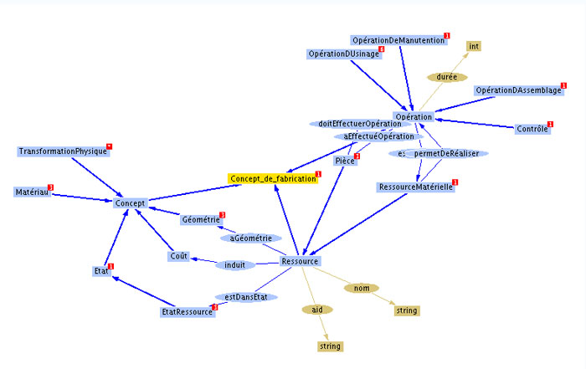
Feasability
Dissertations are online (ETDs) but TDM is not possible (optimal)
Format (PDF processing not optimal for TDM)
Structure (non recognition of relevant sections)
Metadata (discipline, domain…)
Discipline-specific knowledge (and tools)
http://archive.isgtw.org/images/2010/Ontology_L.jpg

Slide 50
Concluding remarks

Slide 51
Open science
Amsterdam Call for Action (2016)
EU copyright reform and national initiatives
Licensing and TDM-friendly formats by publishers
“The Right to Read is the Right to Mine” LERU 2016 (League of European Research Universities)
EU copyright reform (2017?), objective TDM:
“A mandatory exception for research and education purposes;
a mandatory exception that will enable users to text and data mine all content to which they have legal access”
French new Law for a Digital Republic (2016):
TDM exception for scientific documents (if legally accessed)
For scientific purpose, no commercial use

Slide 52
Conditions – A2LF
Availability
Accessibility
Legality
Feasibility

Slide 53
Recommandations
Availability
Retrodigitization
Text and complementary material
Accessibility
Libre open access
Institutional repositories
Legality
TDM exception (or fair use)
Clearance of third party rights (prescription rules)
Feasibility
Standards (prescription rules)
Rich metadata and file structure

Slide 54
References
Pedauque, R. T., 2003. Document: Form, sign and medium, as reformulated for electronic documents. Report, CNRS, Paris. http://archivesic.ccsd.cnrs.fr/sic_00000594/fr/
Murray-Rust, P., 2014. Liberating ETDs to the world and making them useful. In: ETD 2014 17th International Symposium on Electronic Theses and Dissertations, July 23-25, 2014, Leicester, UK. http://www2.le.ac.uk/library/etd2014/plenaries/liberating-etds
Schöpfel, J., Prost, H., Piotrowski, M., Hilf, E. R., Severiens, T., Grabbe, P., 2015. A French-German survey of electronic theses and dissertations: Access and restrictions. D-Lib Magazine 21 (3/4). http://www.dlib.org/dlib/march15/schopfel/03schopfel.html
Schöpfel, J., Juznic, P., Prost, H., Malleret, C., Cesarek, A., Koler-Povh, T., 2015. Dissertations and data (keynote address). In: GL17 International Conference on Grey Literature, 1-2 December 2015, Amsterdam. https://hal.archives-ouvertes.fr/hal-01285304
All references available at http://www.citeulike.org/user/Schopfel/tag/etd2016
Corresponding author: joachim.schopfel@univ-lille3.fr

